Slide 1
Interactive Integrated Exploration and Management of Visualization Parameters
Peter Mindek
Institute of Computer Graphics and Algorithms
Vienna University of Technology

Slide 2
Visualization Pipeline

Slide 3
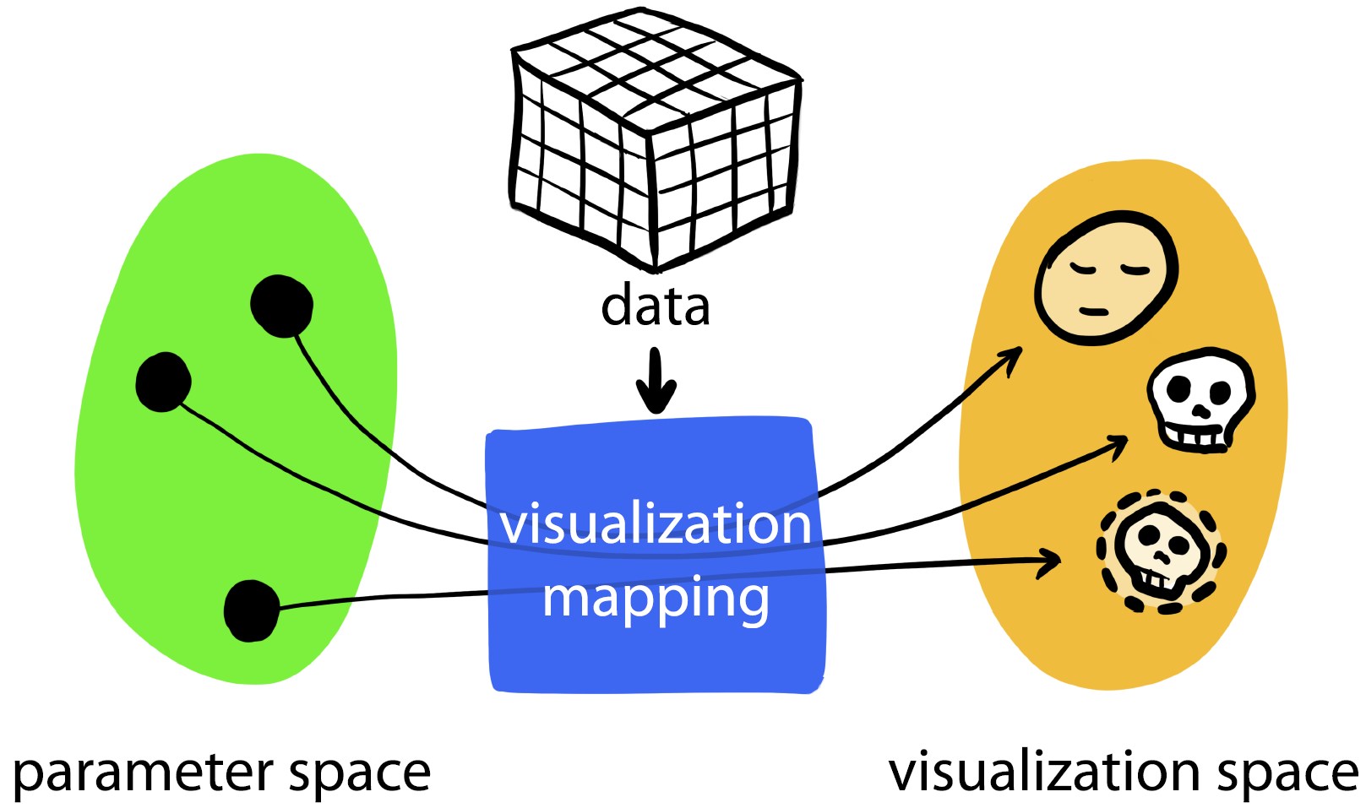
Visualization Mapping
Notes:
!!! Often thought as a function DATA -> IMAGE. We can look at it from a different angle: a function PARAMETERS -> IMAGE parametrized by DATA

Slide 4
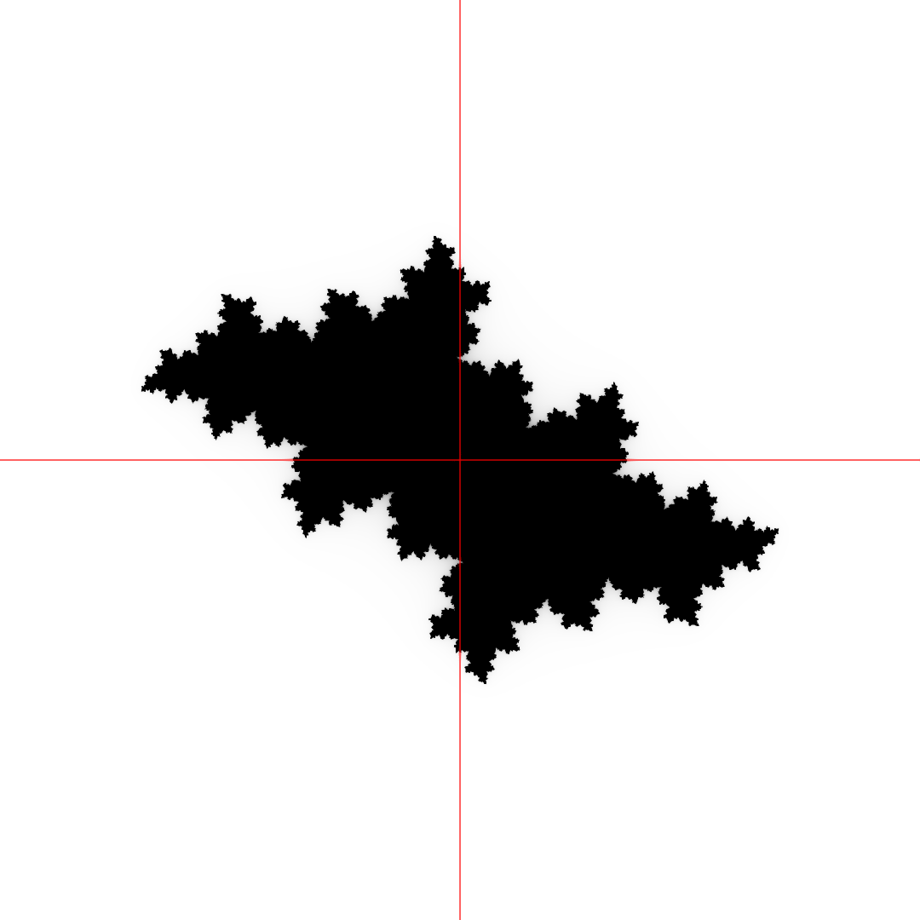
Parameter Spaces – Filled Julia Set
Im
Re
Notes:
Classical example demonstrating how parameter space can be visualized is Filled Julia Set

Slide 5
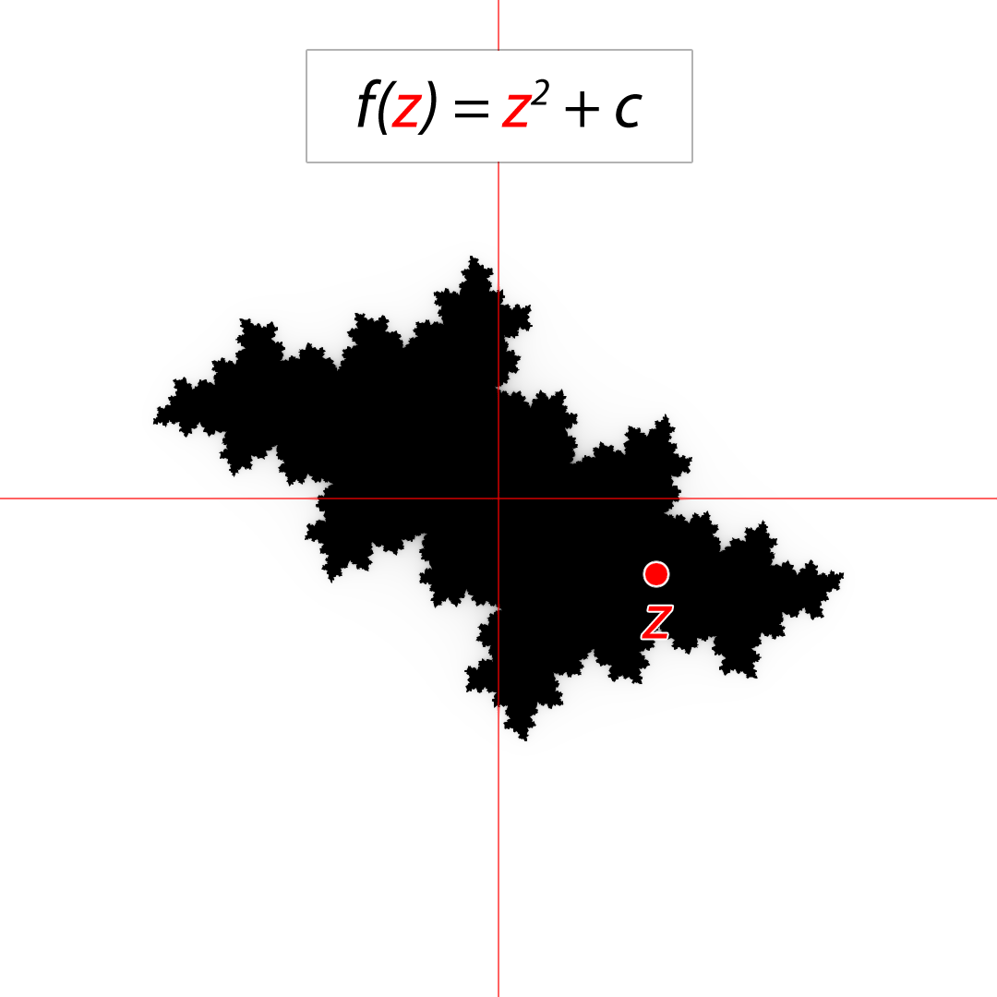
Parameter Spaces – Filled Julia Set
Im
Re

Slide 6
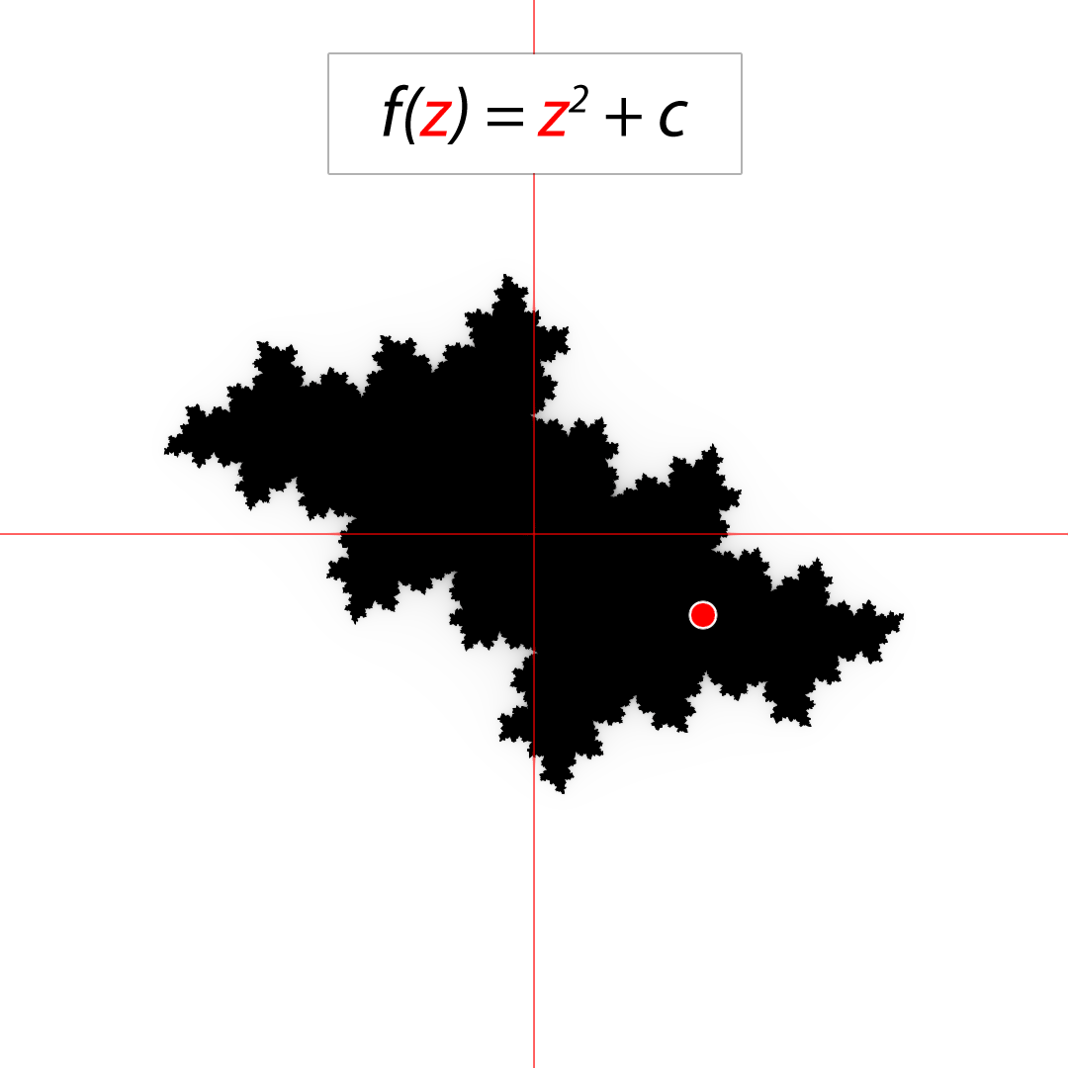
Parameter Spaces – Filled Julia Set
Im
Re

Slide 7
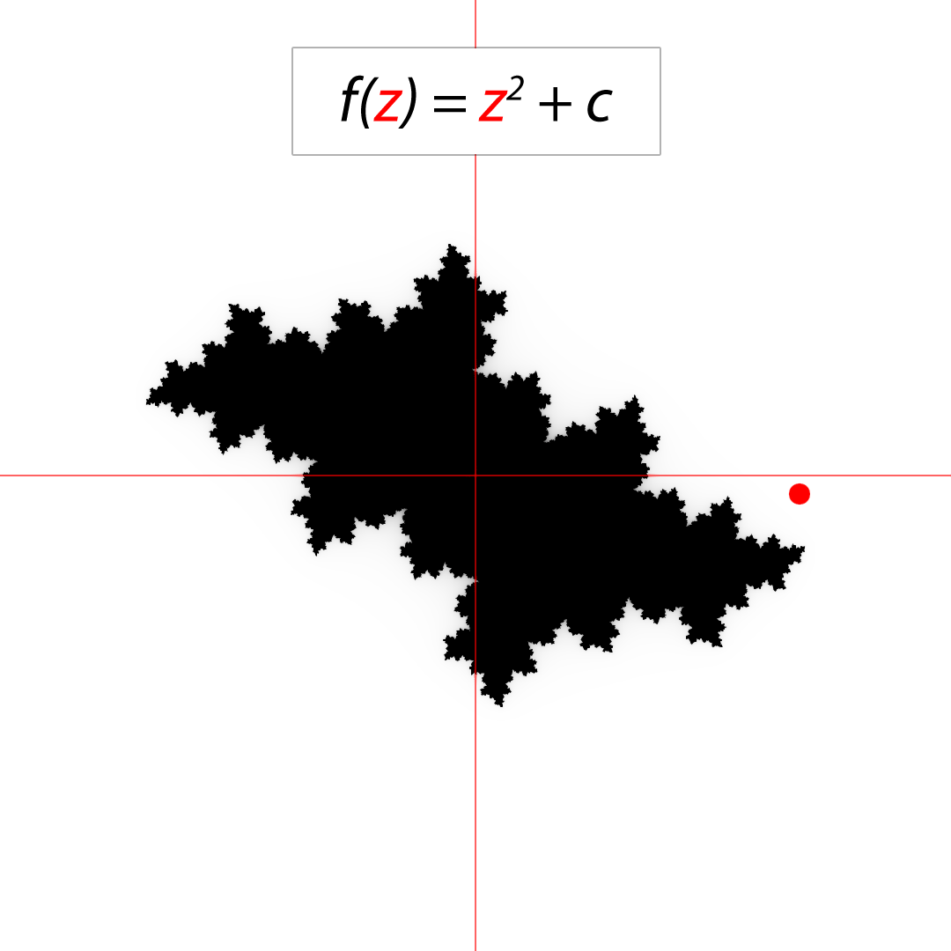
Parameter Spaces – Filled Julia Set
Im
Re

Slide 8
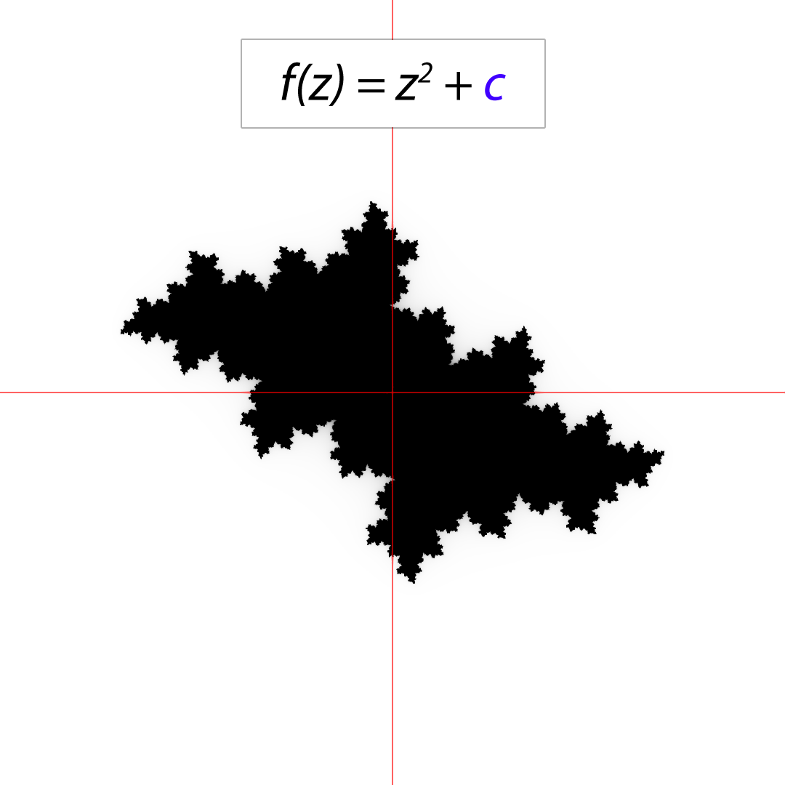
Parameter Spaces – Filled Julia Set
Im
Re

Slide 9
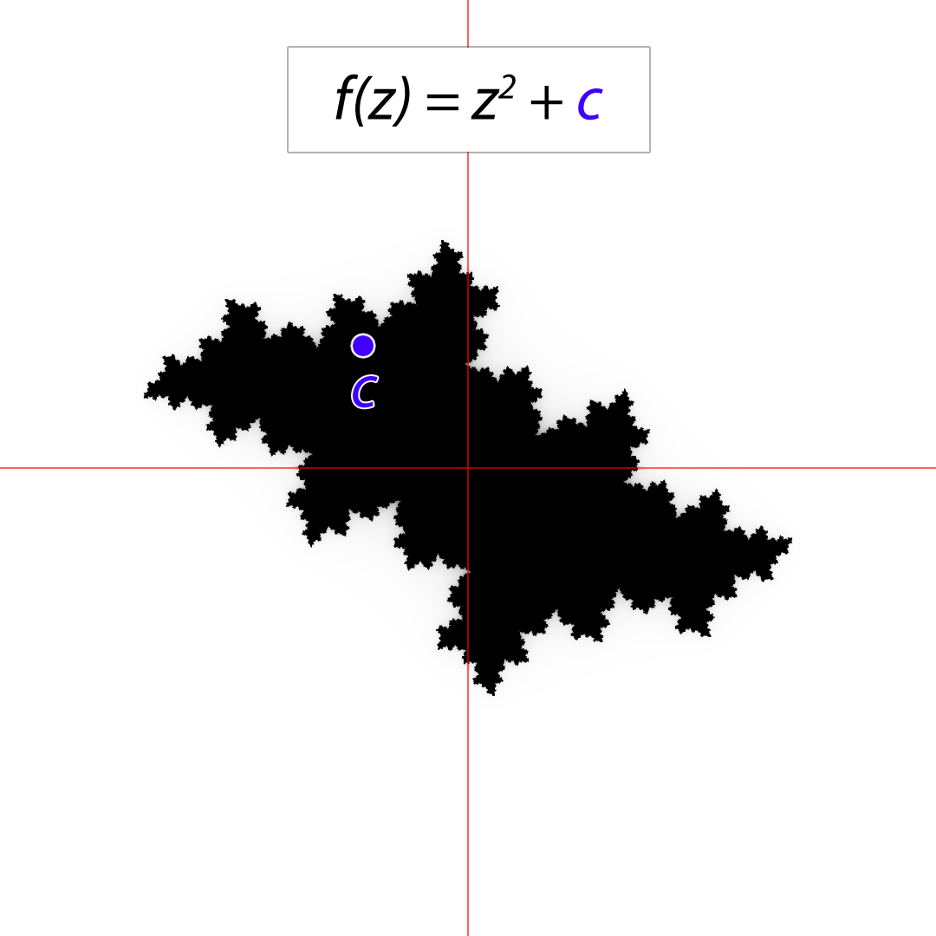
Parameter Spaces – Filled Julia Set
Im
Re

Slide 10
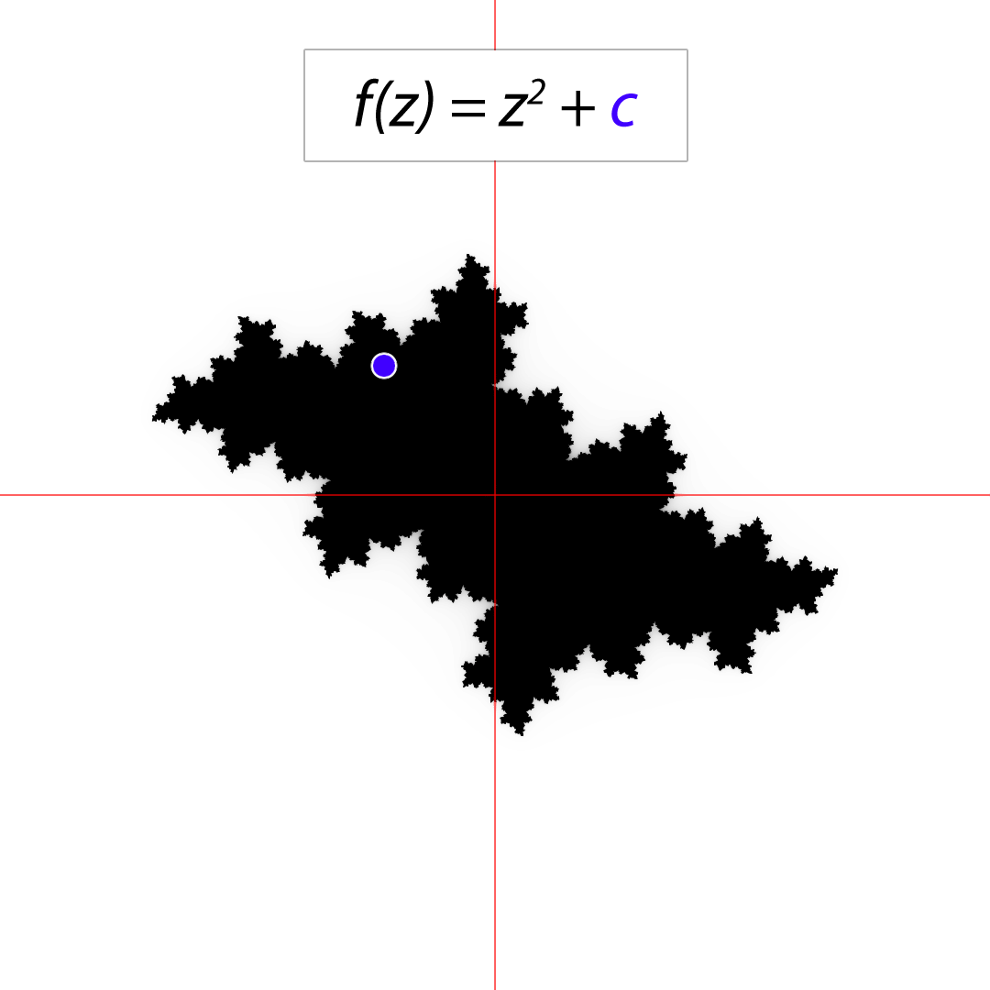
Parameter Spaces – Filled Julia Set
Im
Re

Slide 11
Visualization of Parameter Spaces
Im
Re

Slide 12
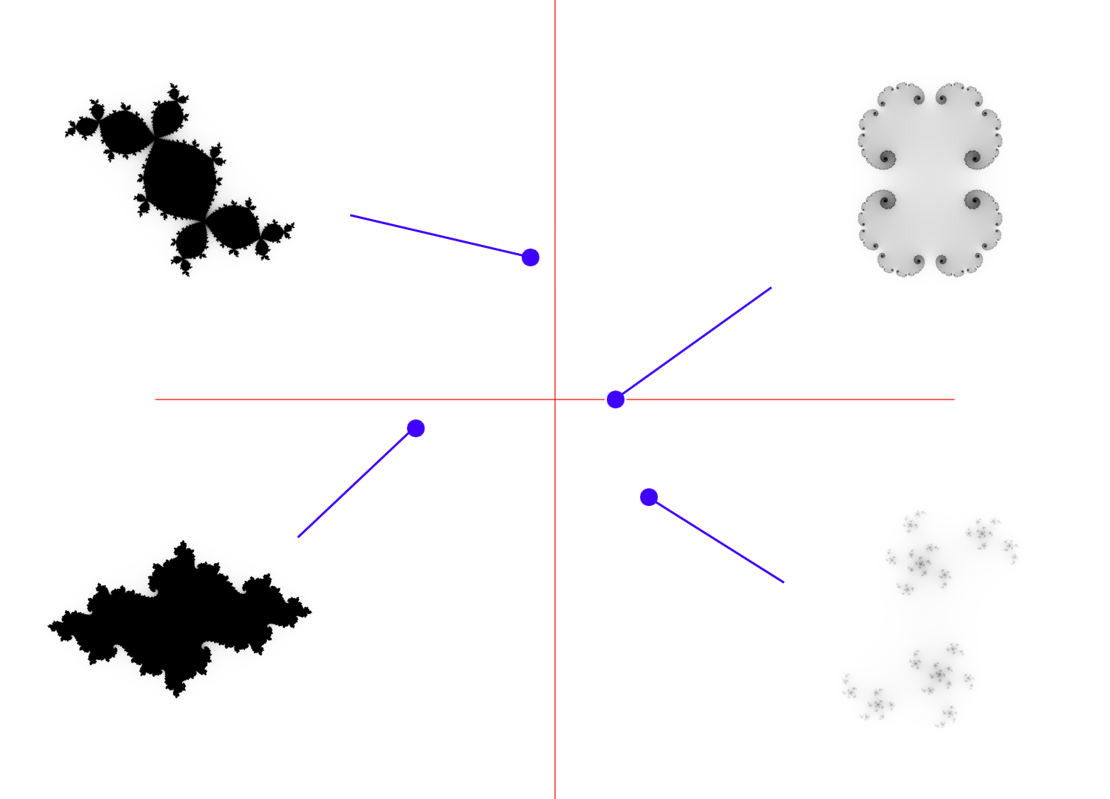
Visualization of Parameter Spaces
Im
Re

Slide 13
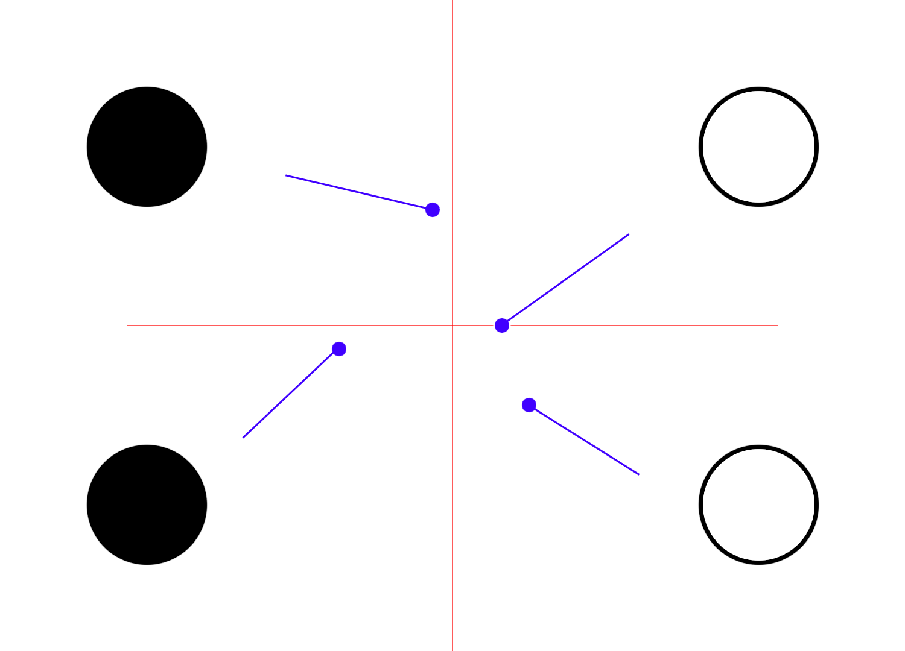
Visualization of Parameter Spaces
Im
Re

Slide 14
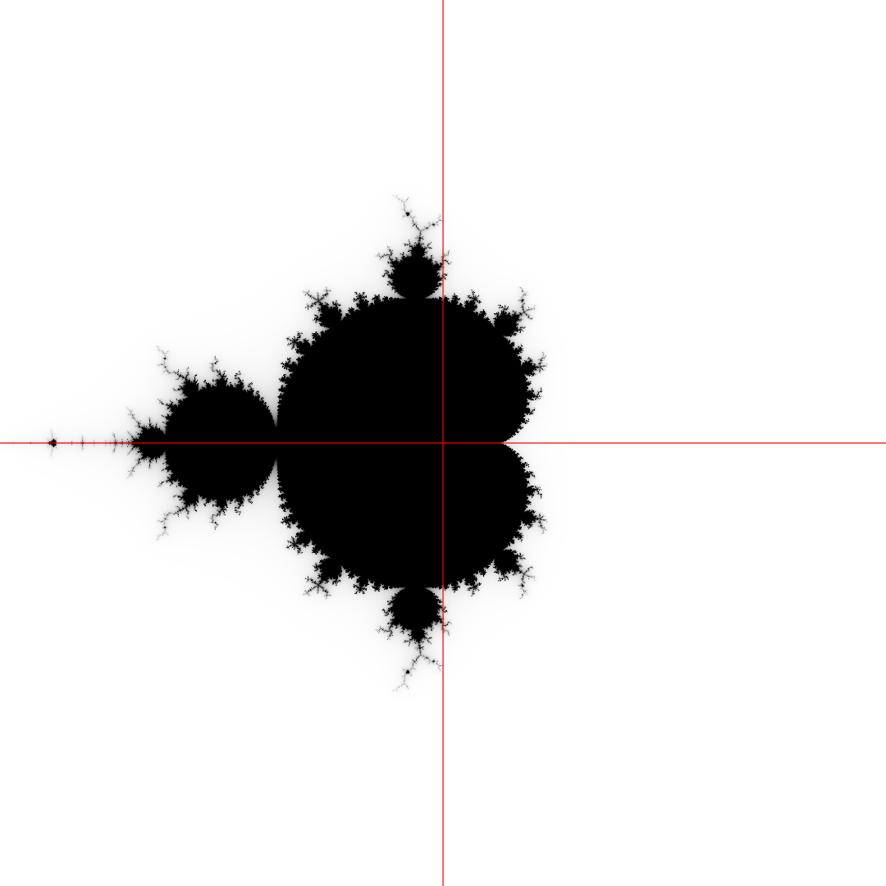
Visualization of Parameter Spaces
Im
Re
Notes:
This visualization is indicating all possible Filled Julia sets within the given range.

Slide 15
Visualization of Parameter Spaces
Im
Re

Slide 16
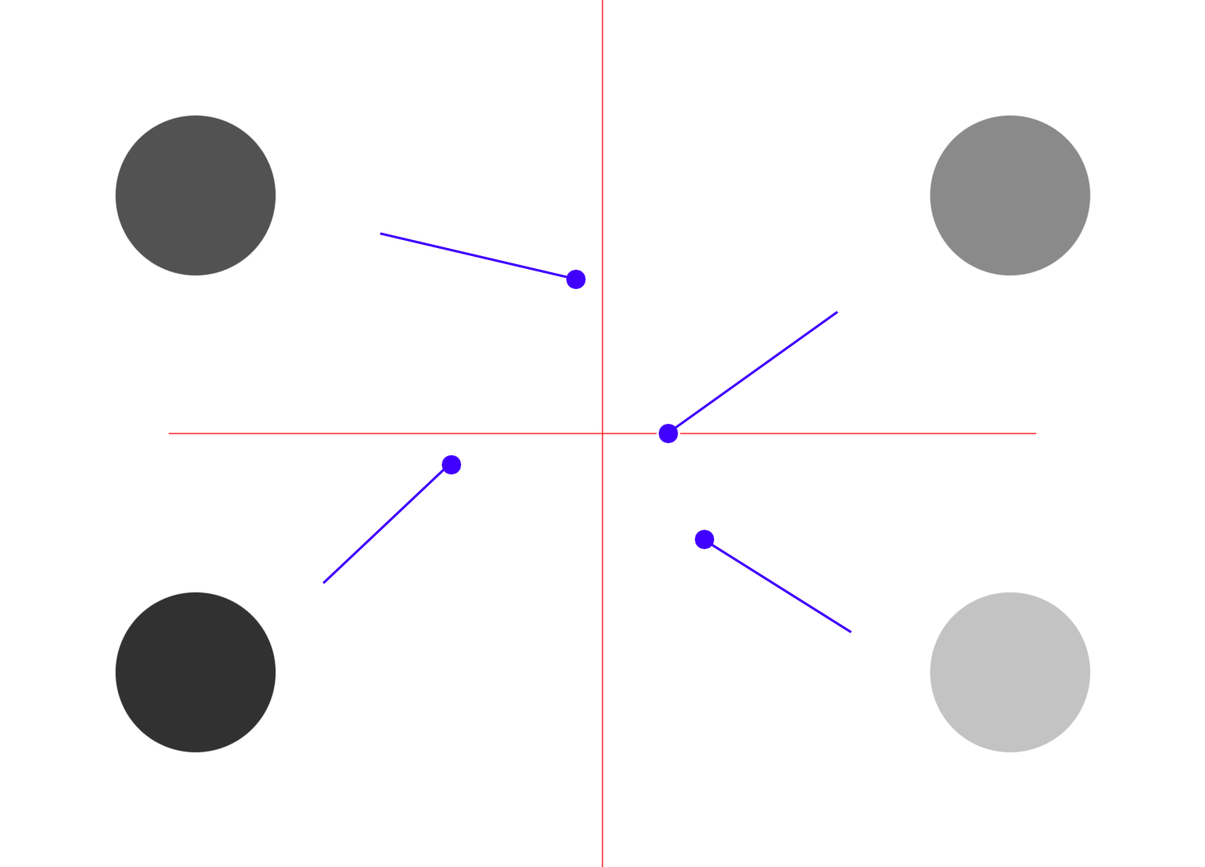
Visualization of Parameter Spaces
Im
Re

Slide 17
Visualization of Parameter Spaces
Im
Re

Slide 18
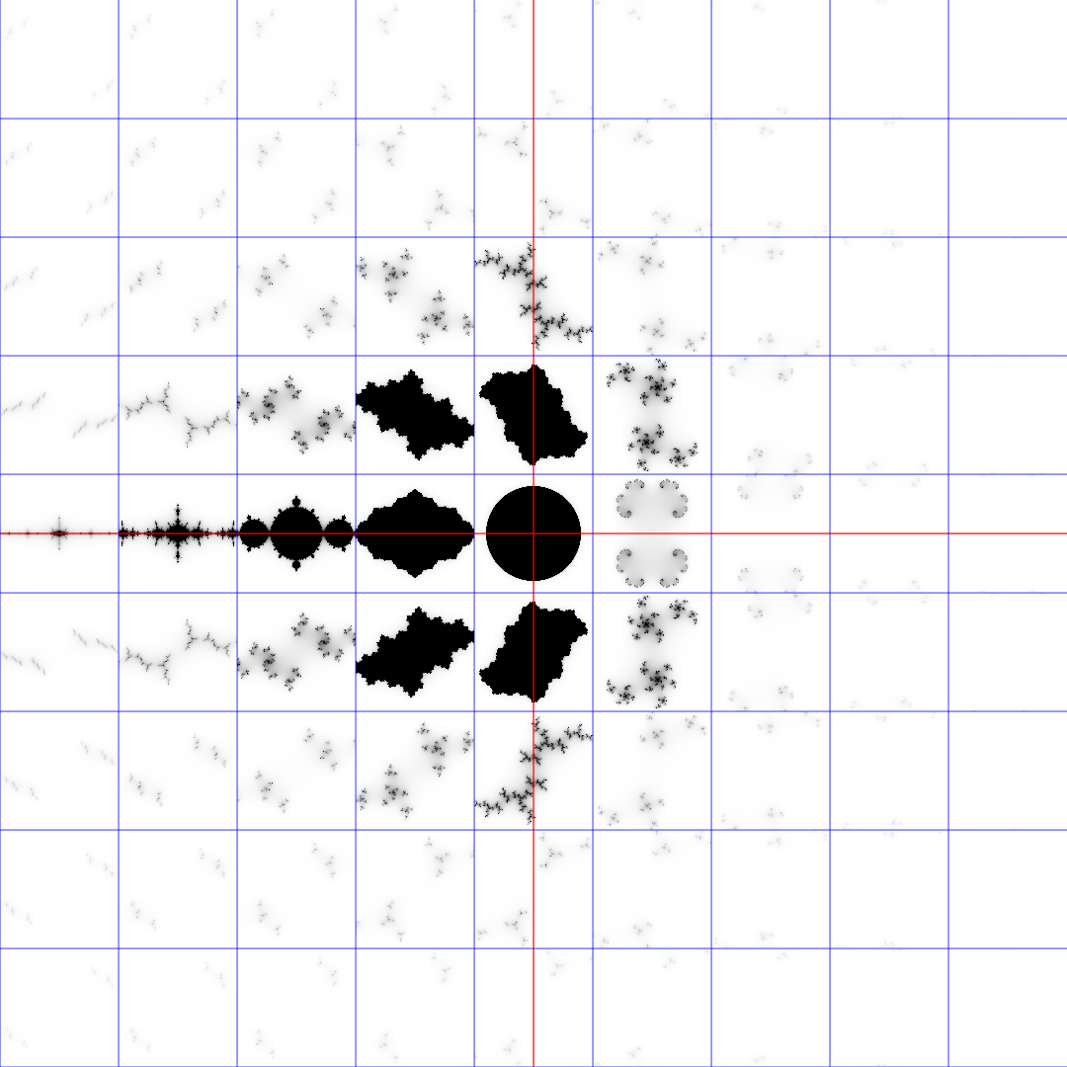
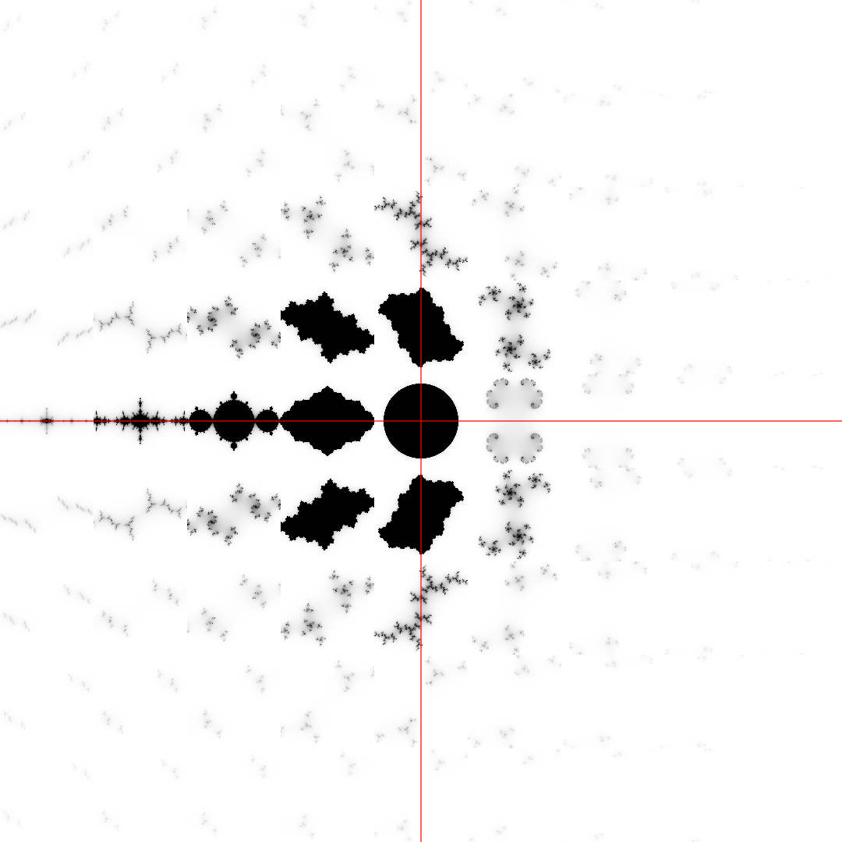
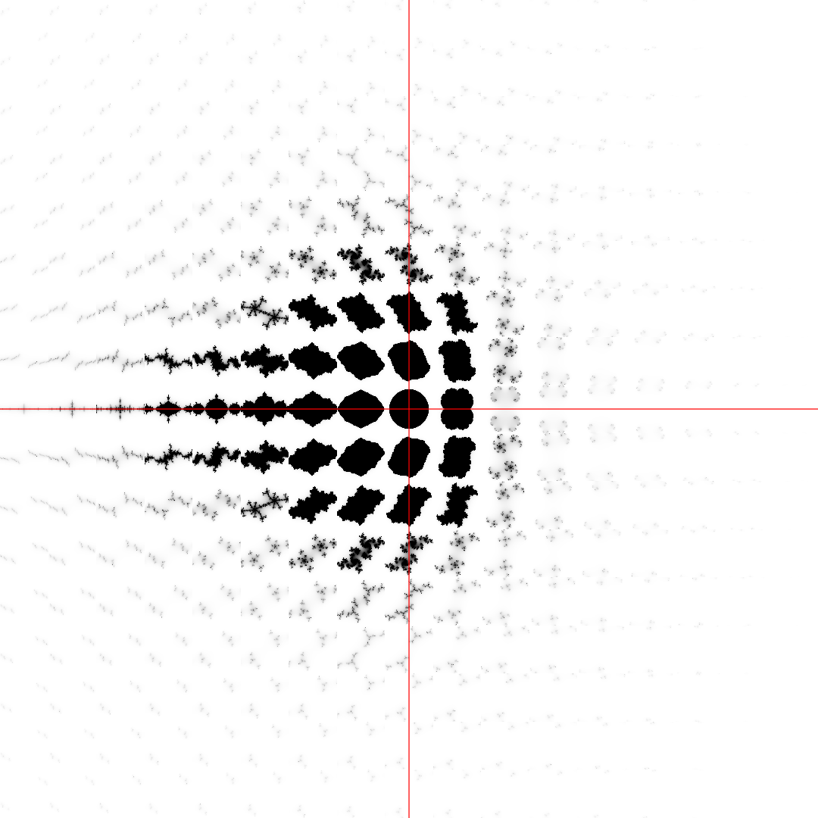
Visualization of Parameter Spaces
Im
Re

Slide 19
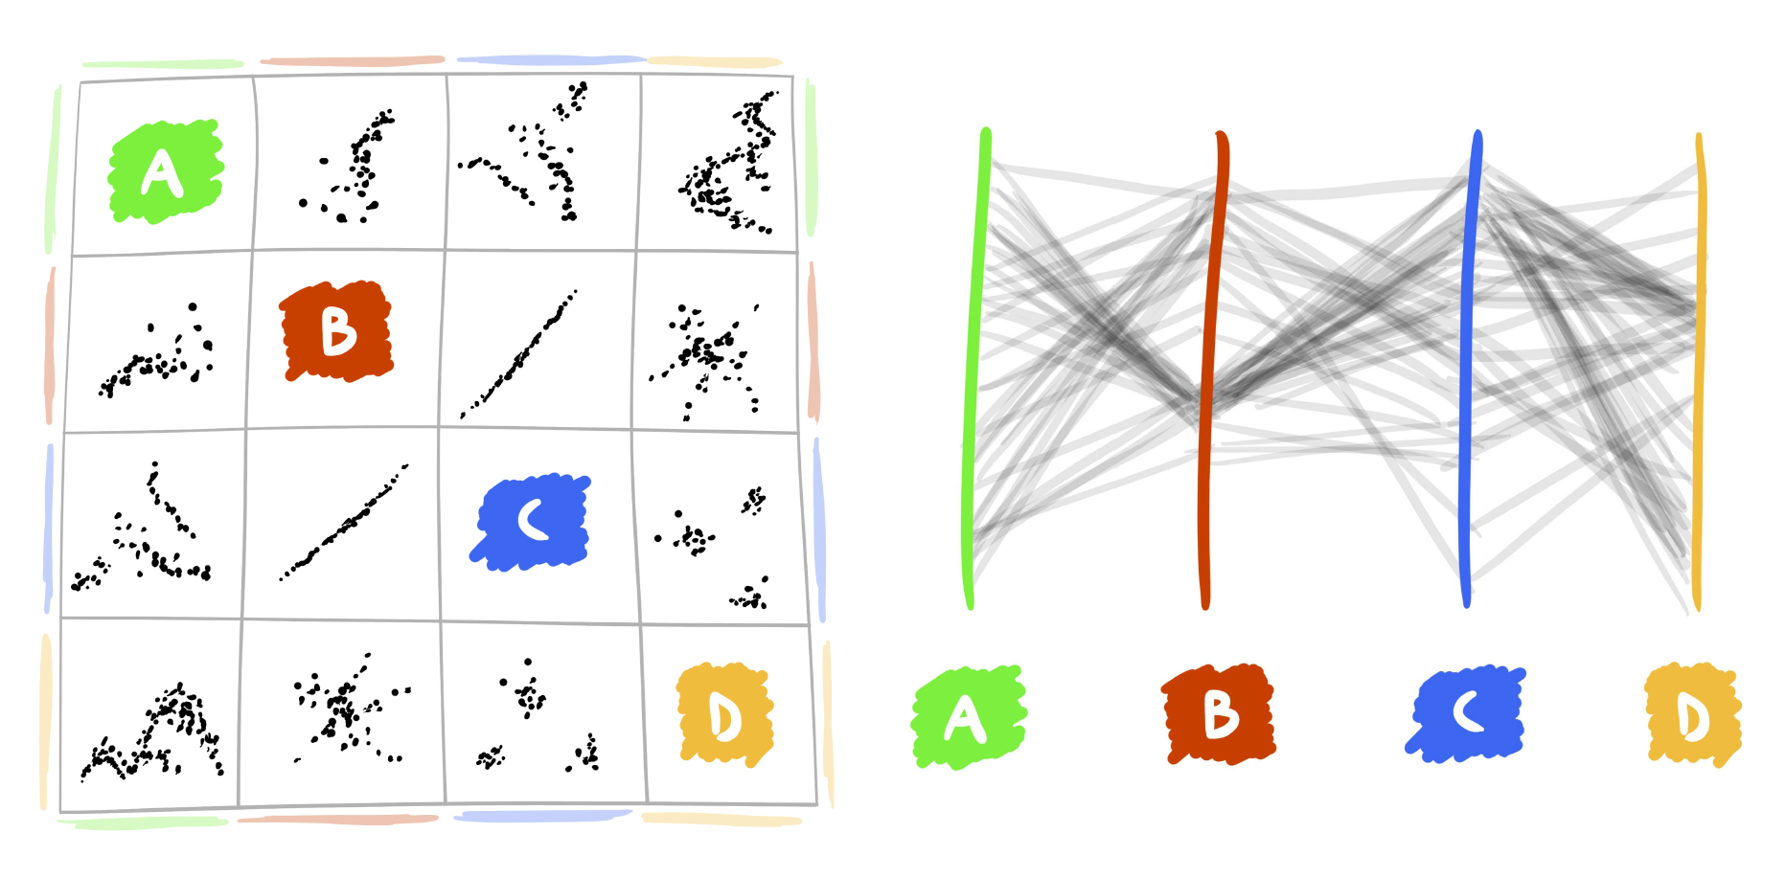
Multi-Dimensional Parameter Spaces
Notes:
Parameters of a single visualization.

Slide 20
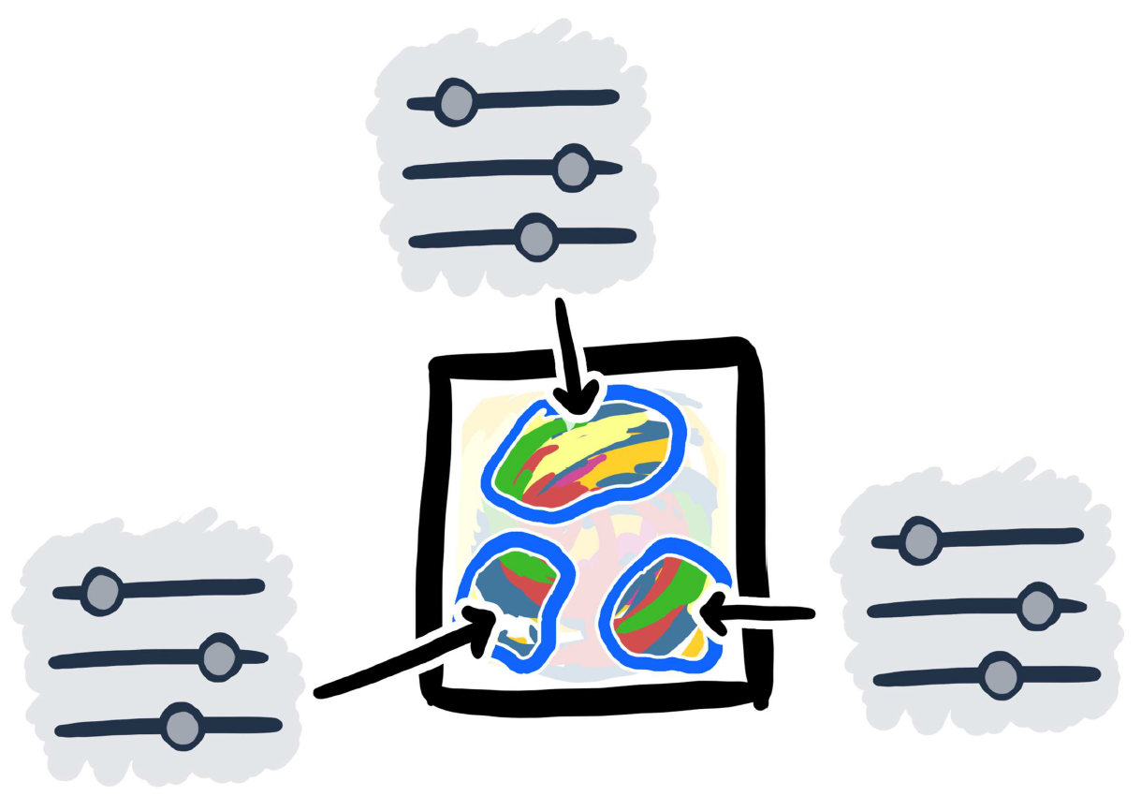
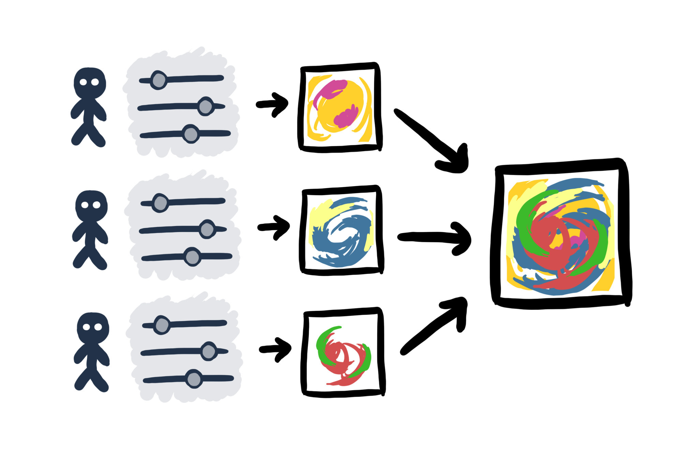
Researched Areas
Single Visualization
Multiple Parameter Settings
Multiple Users
Interaction

Slide 21
Publications
P. Mindek, S. Bruckner, P. Rautek, M. E. Gröller. Visual Parameter Exploration in GPU Shader Space. Journal of WSCG 21, 3 (2013), pp. 225—234. ISSN 1213-6972.
P. Mindek, M. E. Gröller, and S. Bruckner. Managing Spatial Selections with Contextual Snapshots. Computer Graphics Forum 33, 8 (2014), pp. 132—144. DOI: 10.1111/cgf.12406.
P. Mindek, S. Bruckner, M. E. Gröller. Contextual Snapshots: Enriched Visualization with Interactive Spatial Annotations. In Spring Conference on Computer Graphics, SCCG’13, pp. 49—56, New York, NY, USA, 2013. ACM. The Best Paper Award.
P. Mindek, L. Čmolík, I. Viola, M. E. Gröller, S. Bruckner. Automatized Summarization of Multiplayer Games. In Spring Conference on Computer Graphics, SCCG’15, pp. 93—100, Bratislava, Slovakia, Comenius University in Bratislava. The Best Paper Award.
P. Mindek, G. Mistelbauer, M. E. Gröller, and S. Bruckner. Data-Sensitive Navigation in Scientific Visualization. Technical Report TR-186-2-15-01. Institute of Computer Graphics and Algorithms, Vienna University of Technology. April 2015.

Slide 22
1. Single Visualization
P. Mindek, S. Bruckner, P. Rautek, M. E. Gröller. Visual Parameter Exploration in GPU Shader Space. Journal of WSCG 21, 3 (2013), pp. 225—234. ISSN 1213-6972
Notes:
10 min
Parameters of a single visualization.

Slide 23
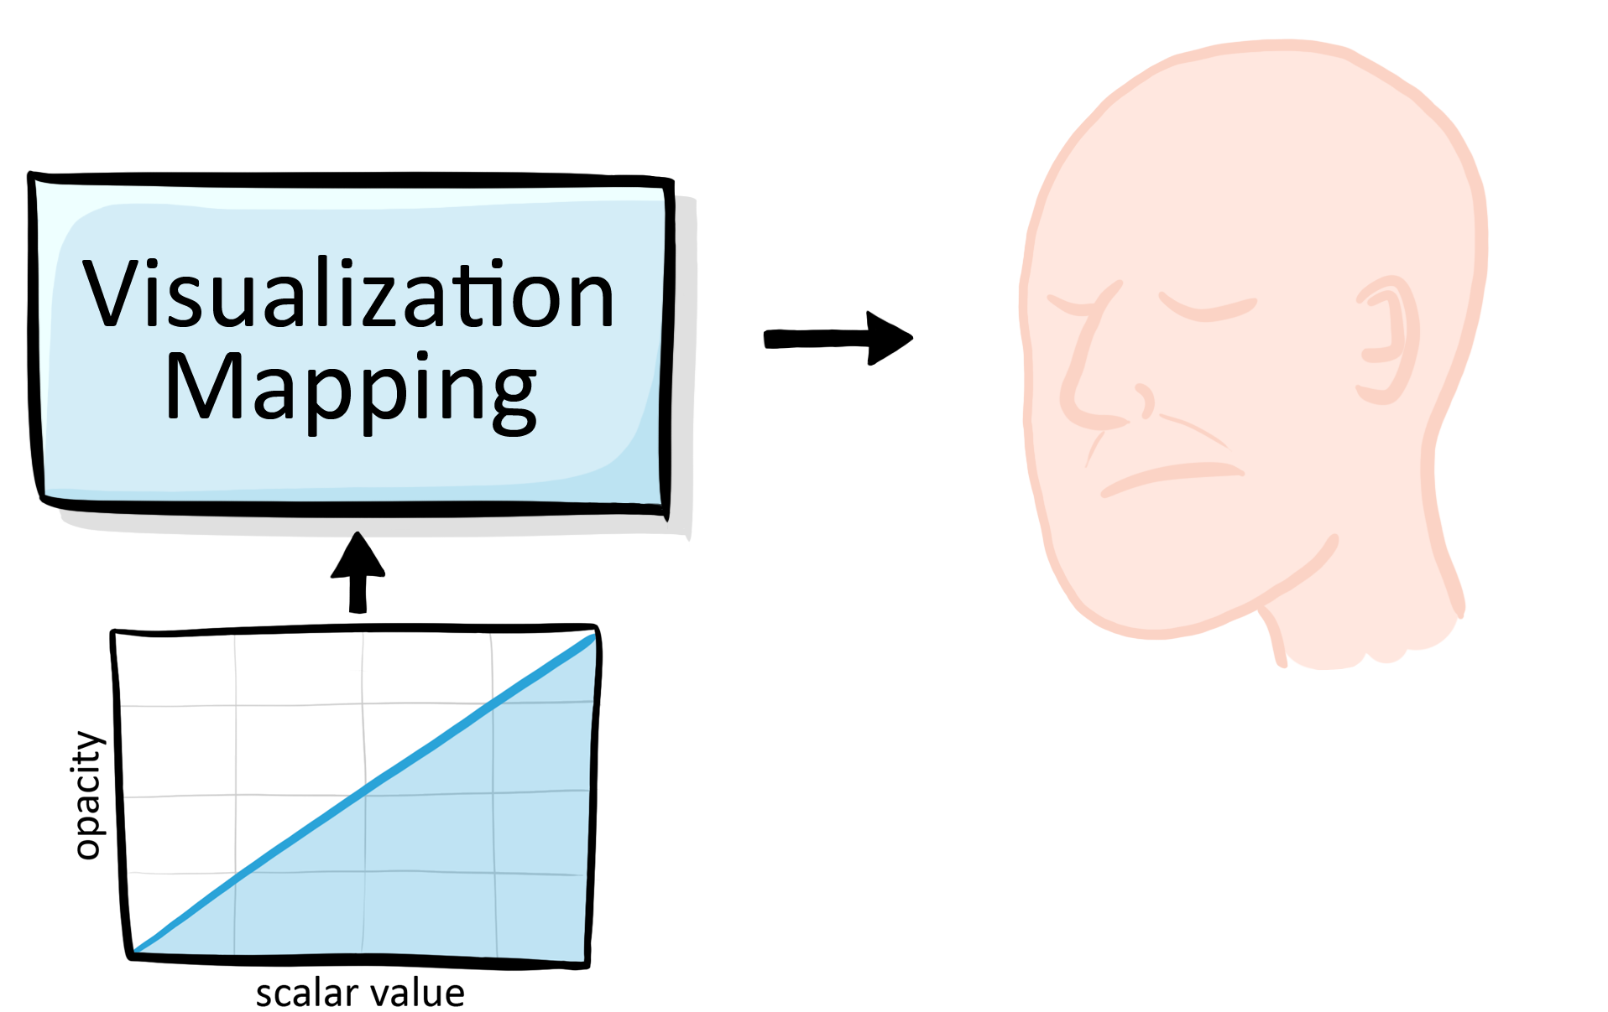
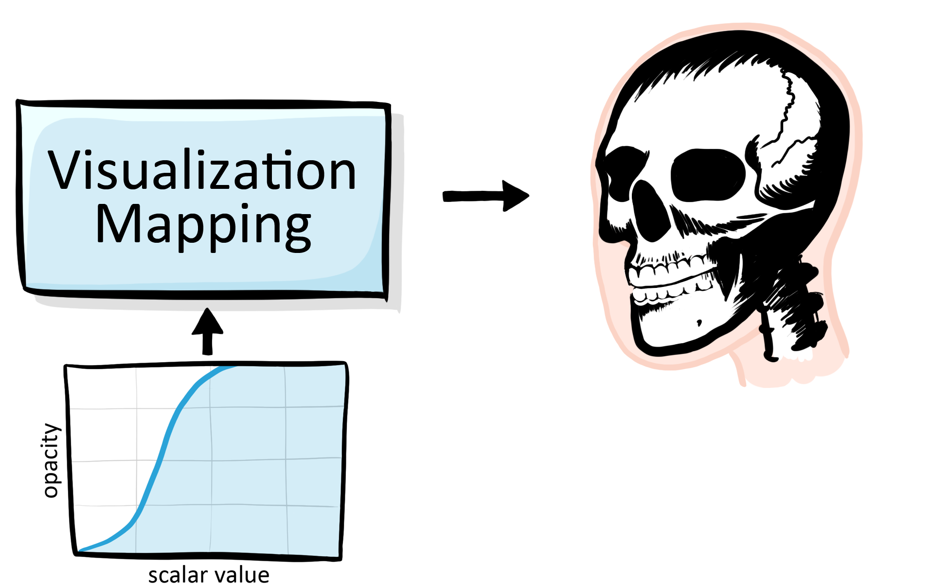
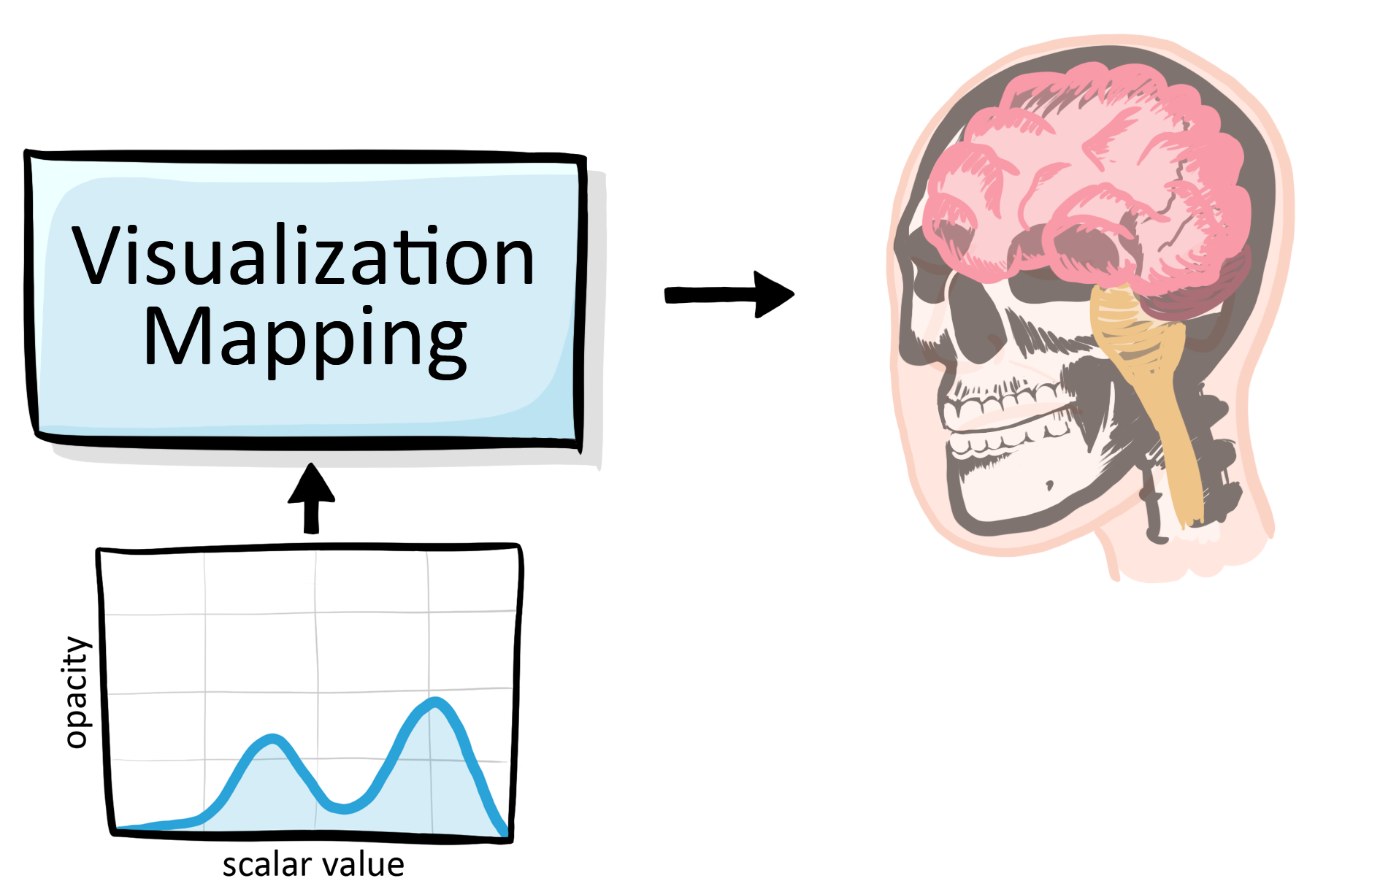
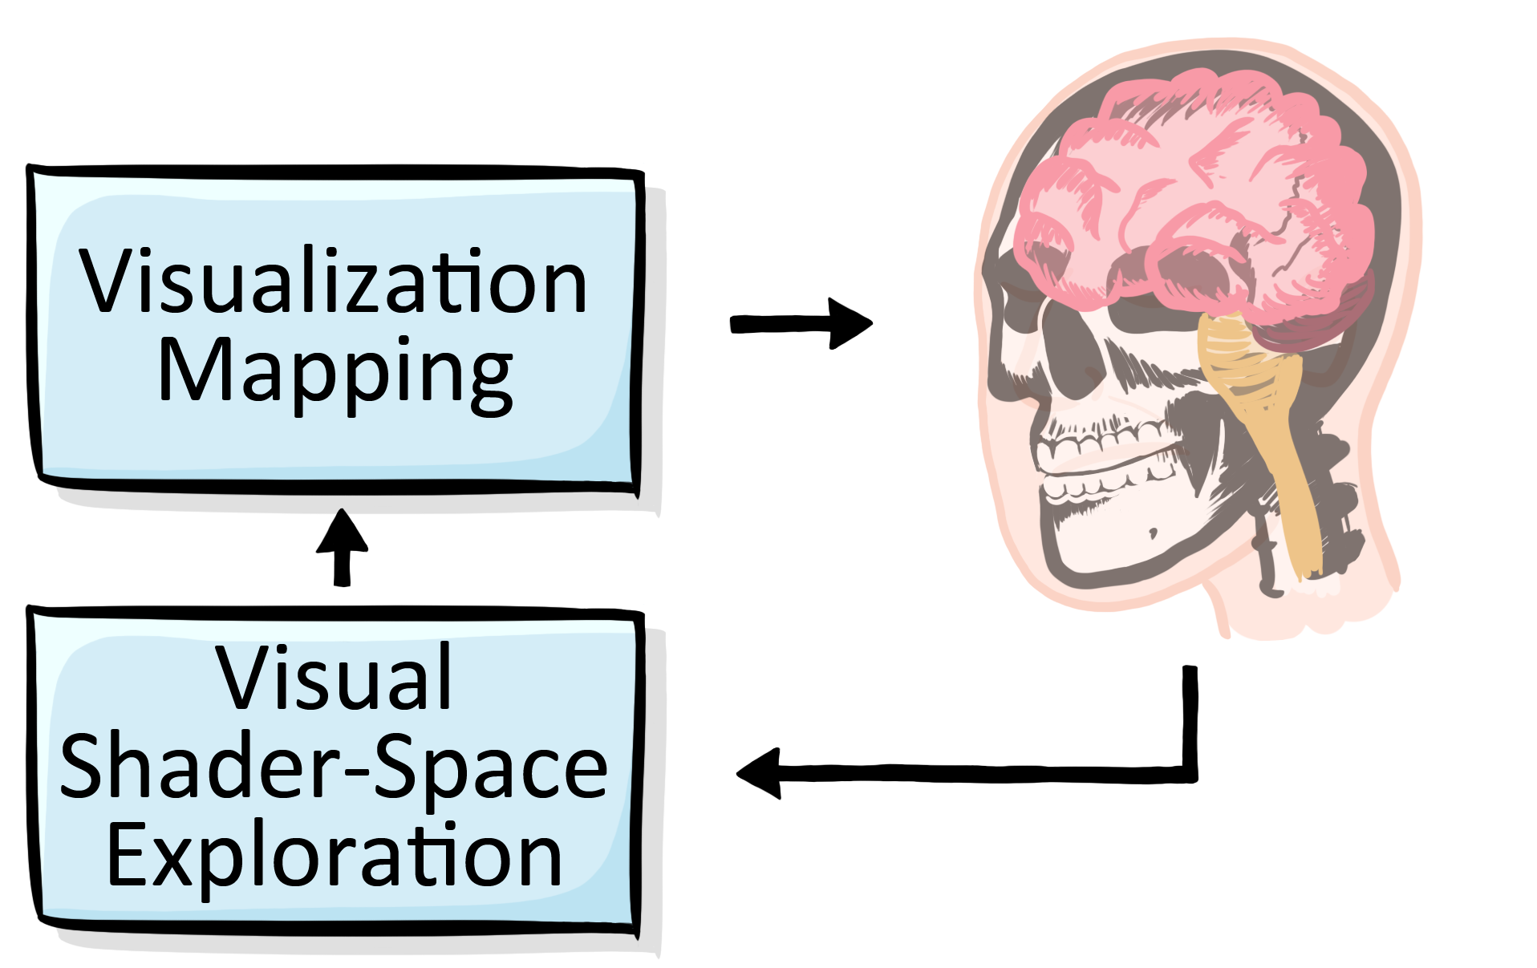
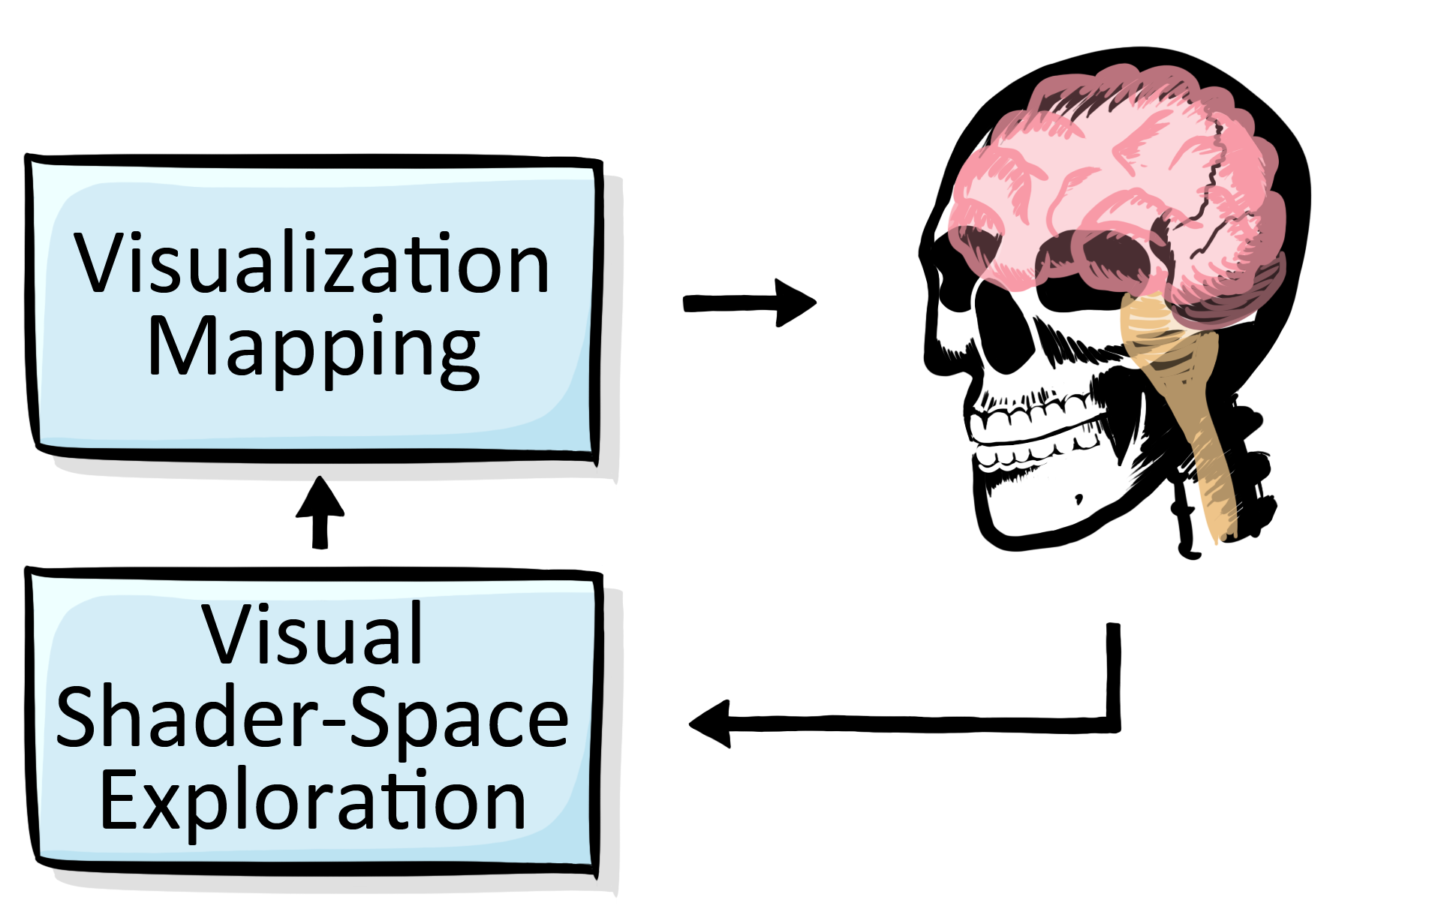
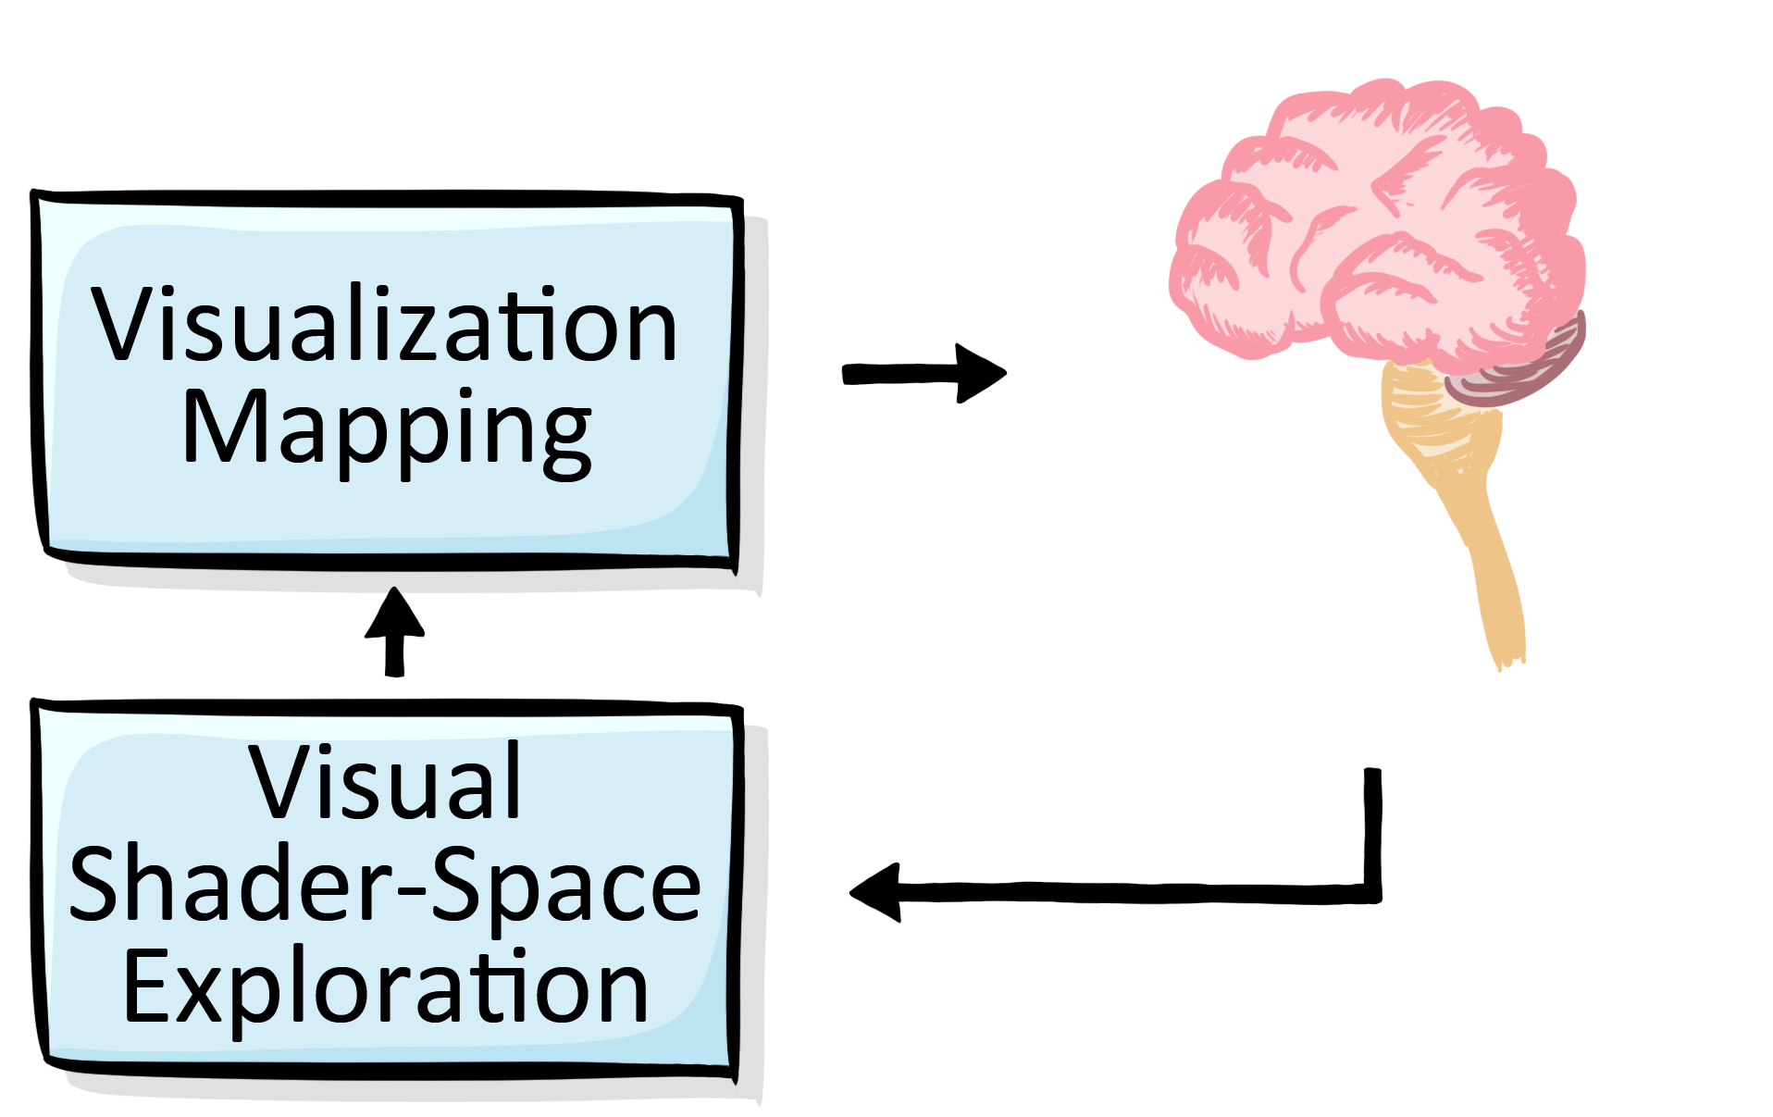
Overview

Slide 24
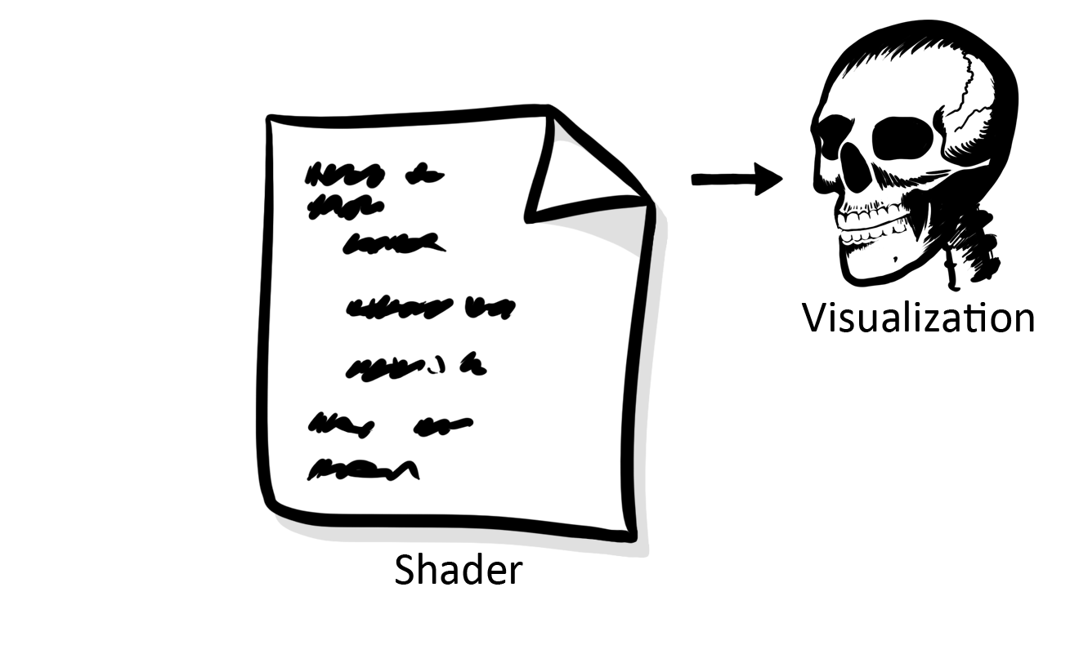
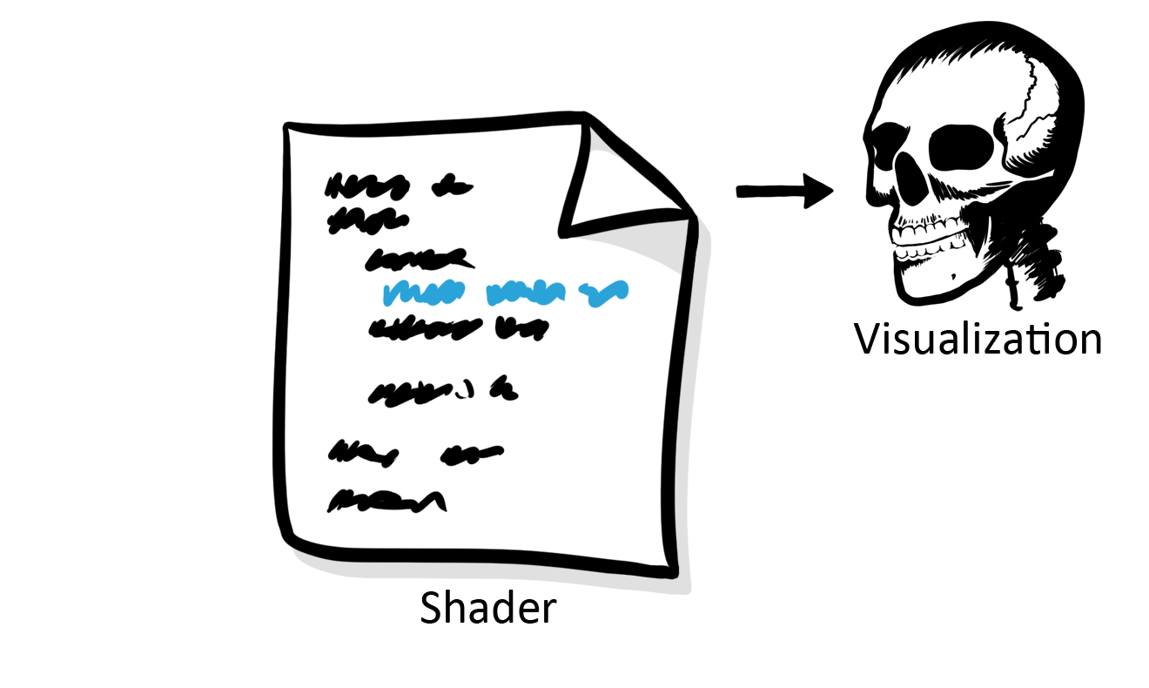
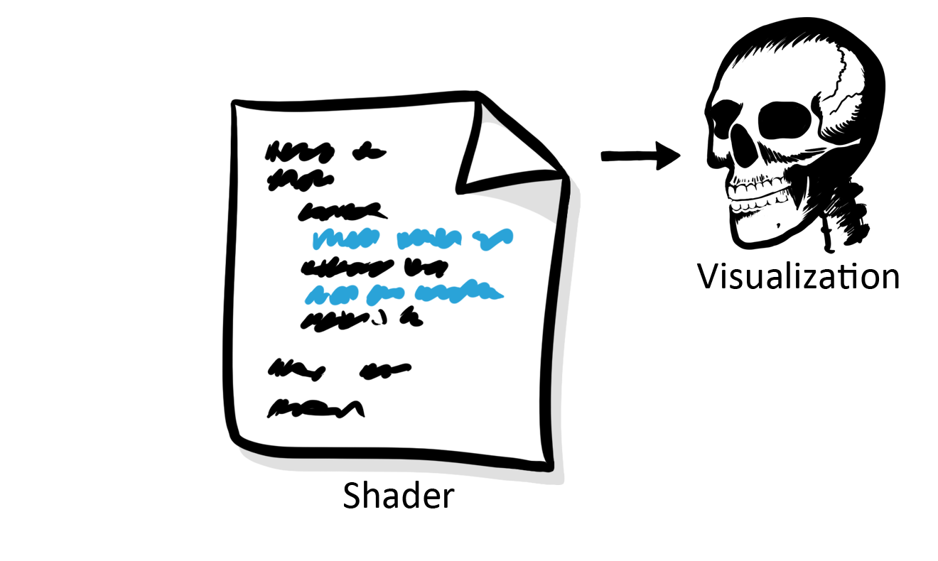
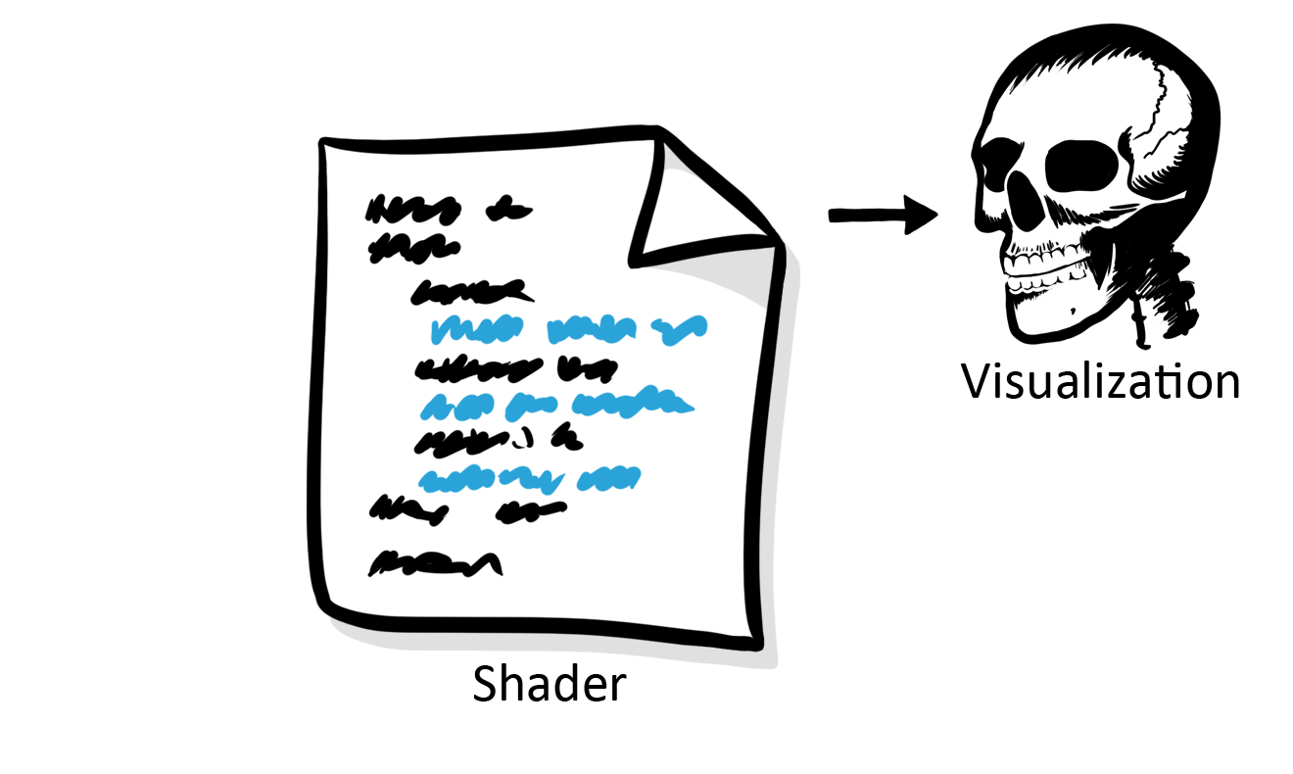
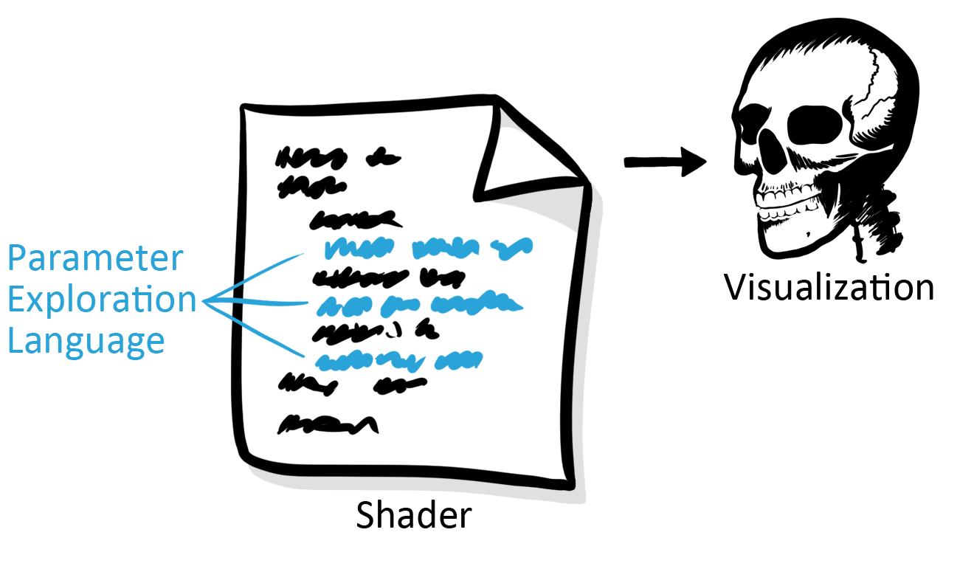
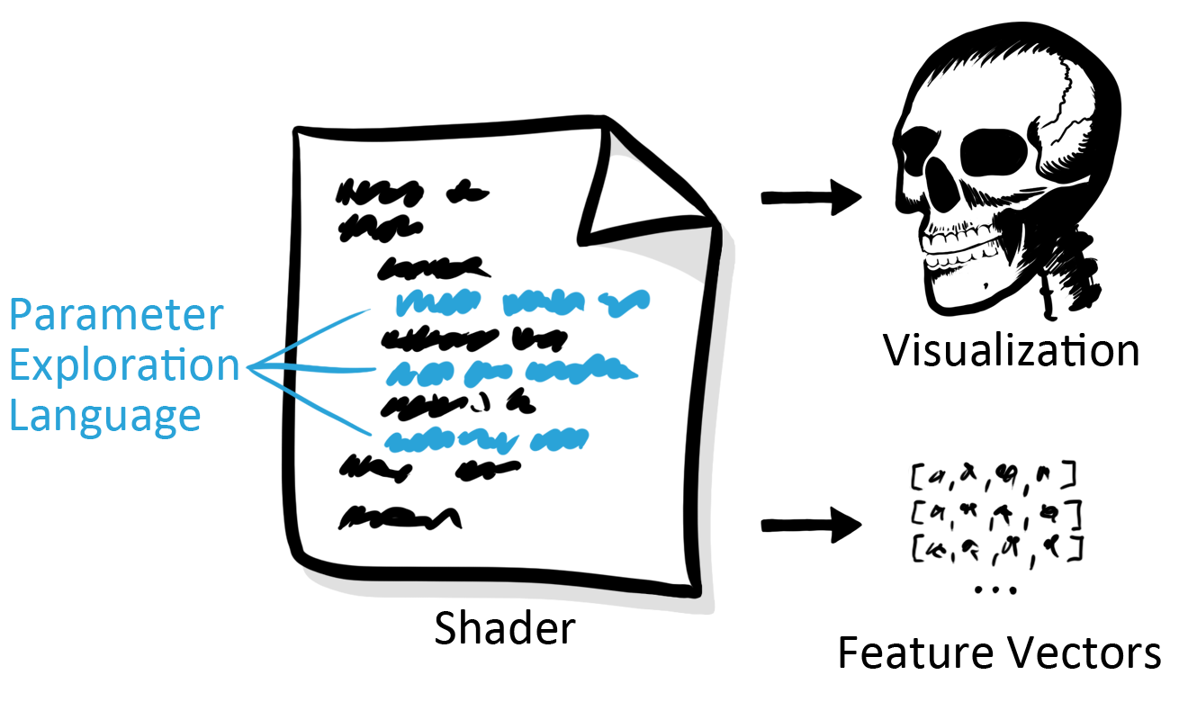
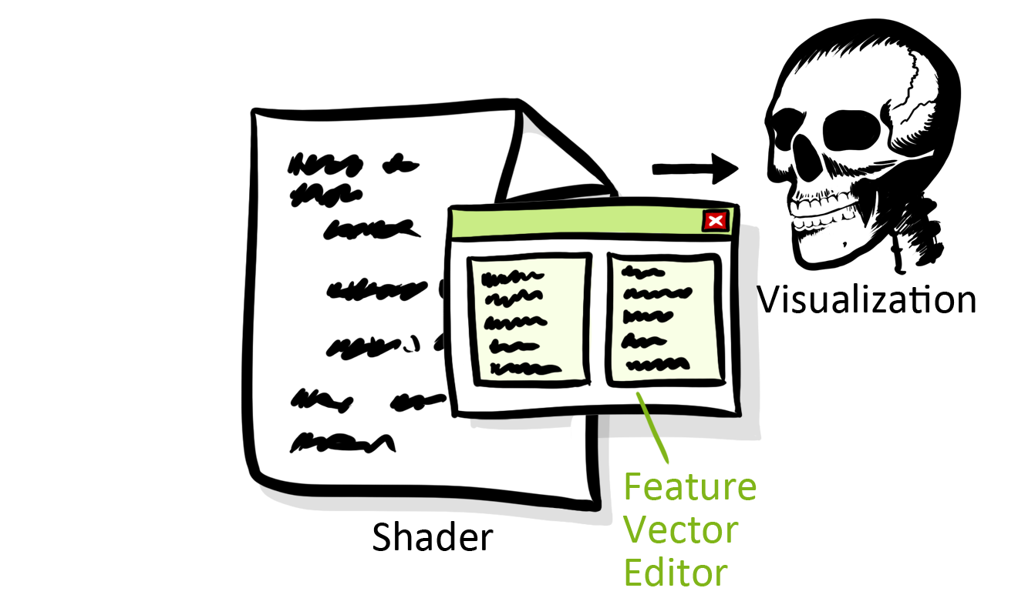
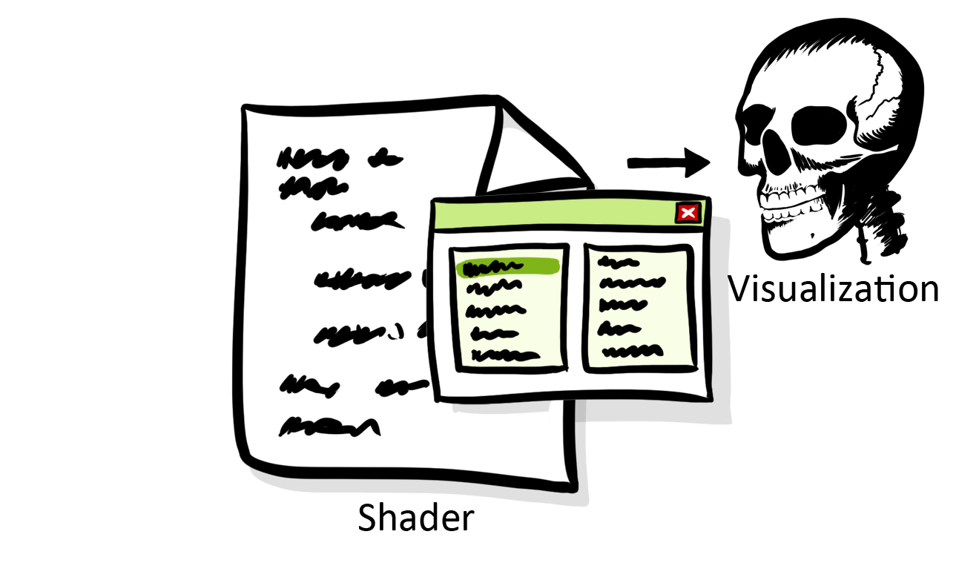
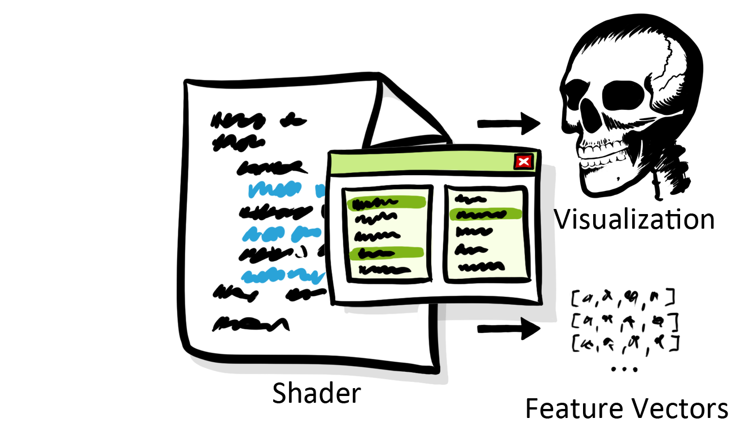
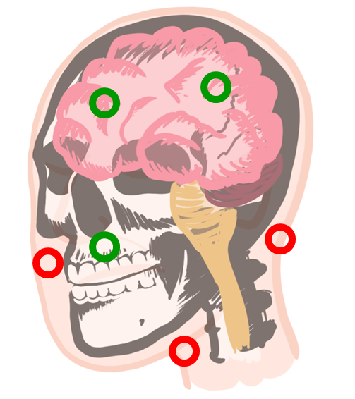
Contributions
Notes:
Existing work: Machine learning, WYSIWYG volume visualization
They are for adjusting transfer functions, NOT for exploration.
We allow

Slide 25
Parameter Exploration Language
...
float vox = dataRead(p);
float gm = length(gradient);
accumC += (1.0 - accumA) * color.rgb * vox;
accumA += (1.0 - accumA) * vox;
...

Slide 26
Parameter Exploration Language
...
//. name Scalar Value
float vox = dataRead(p);
//. name Gradient Magnitude
float gm = length(gradient);
//. vector vox; gm; (1.0 - accumA) * vox
accumC += (1.0 - accumA) * color.rgb * vox;
accumA += (1.0 - accumA) * vox;
...

Slide 27
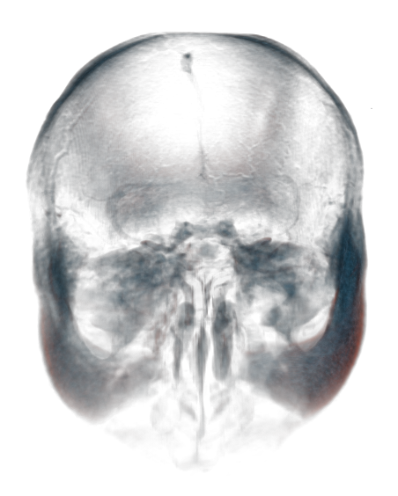
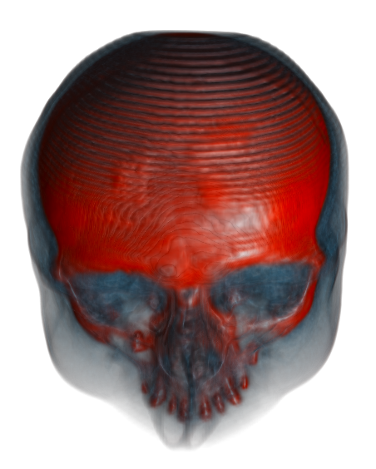
Data
Hard Tissues
MRI CT

Slide 28
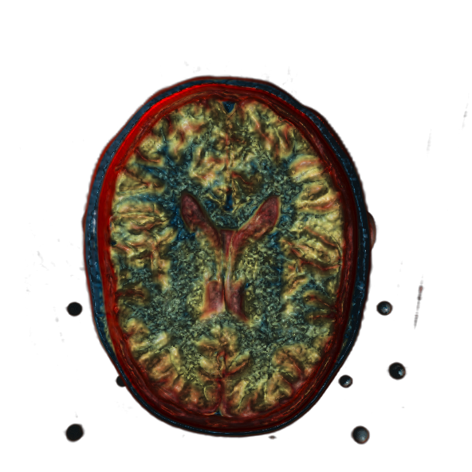
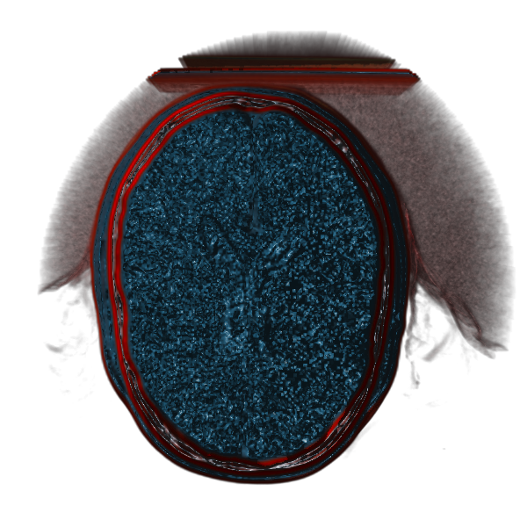
Data
Soft Tissues
MRI CT

Slide 29
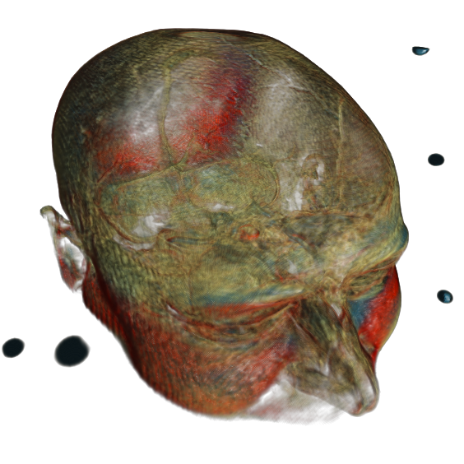
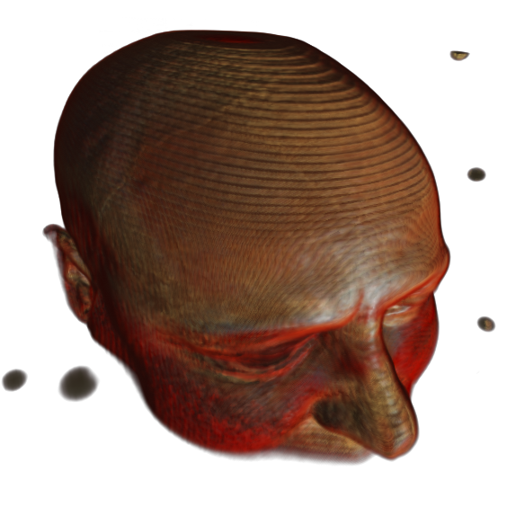
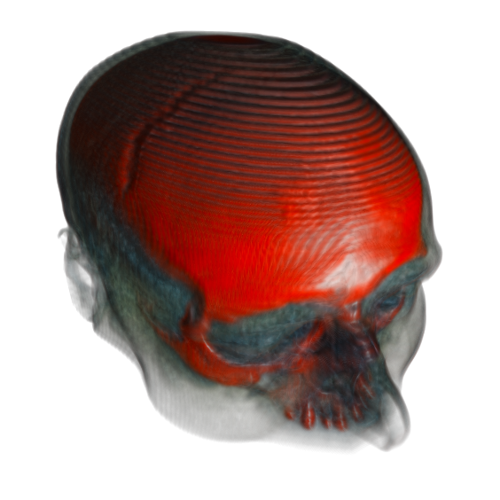
Data
MRI CT
Co-registered CT and MRI scans

Slide 30
Goal
Which attributes can be used to differentiate the brain from other tissues?
Data Attribute | Shader Variable
CT scalar value | voxCT
MRI scalar value | voxMRI
CT gradient magnitude | gmCT
MRI gradient magnitude | gmMRI
abs(voxCT – voxMRI) | voxDiff
abs(gmCT – gmMRI) | gmDiff
max(voxCT, voxMRI) | voxMax
max(gmCT, gmMRI) | gmMax

Slide 31
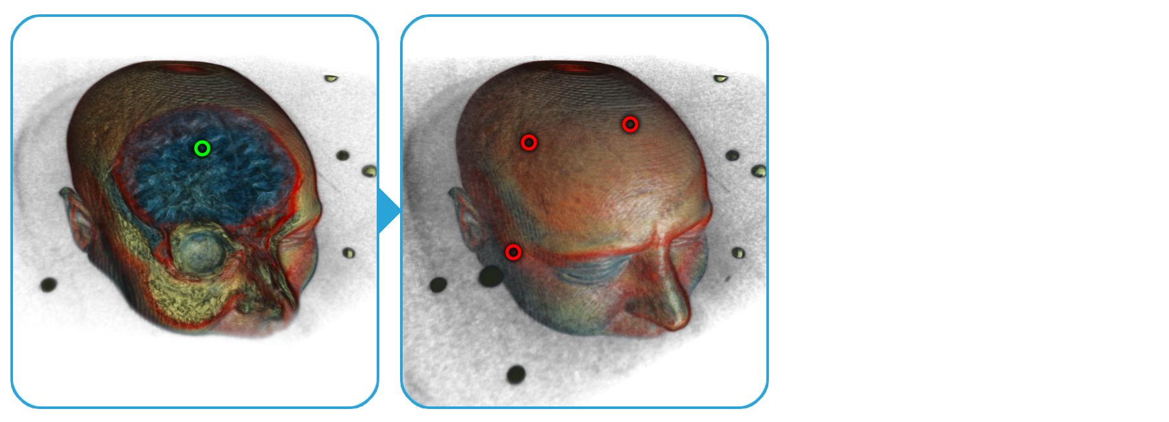
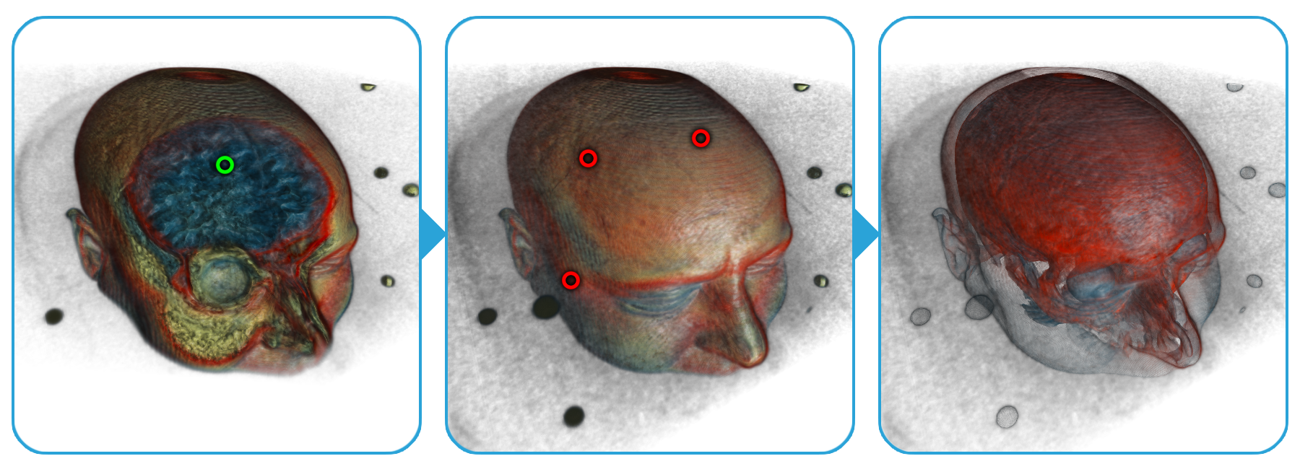
Results
voxMRI

Slide 32
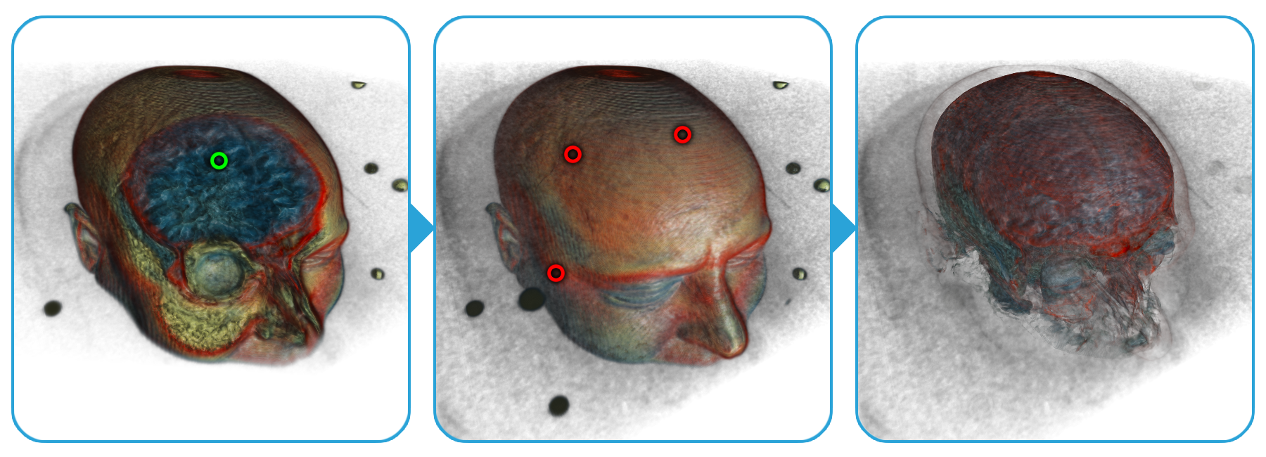
Results
voxMRI
gmMRI

Slide 33
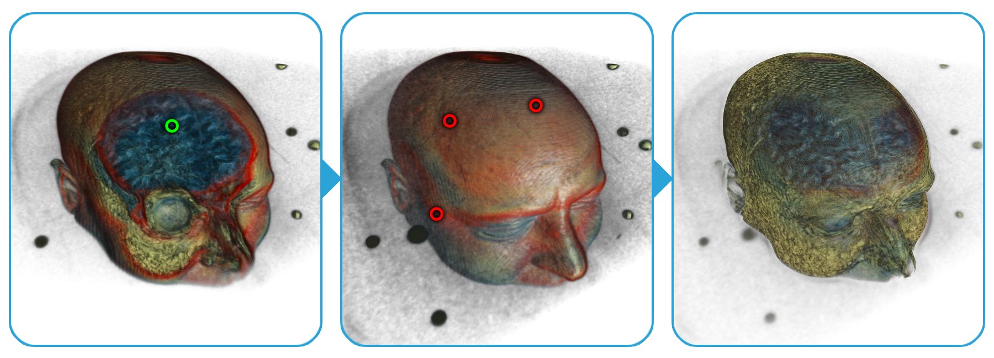
Results
voxCT voxDiff
voxMRI voxMax
gmCT gmDiff
gmMRI gmMax

Slide 34
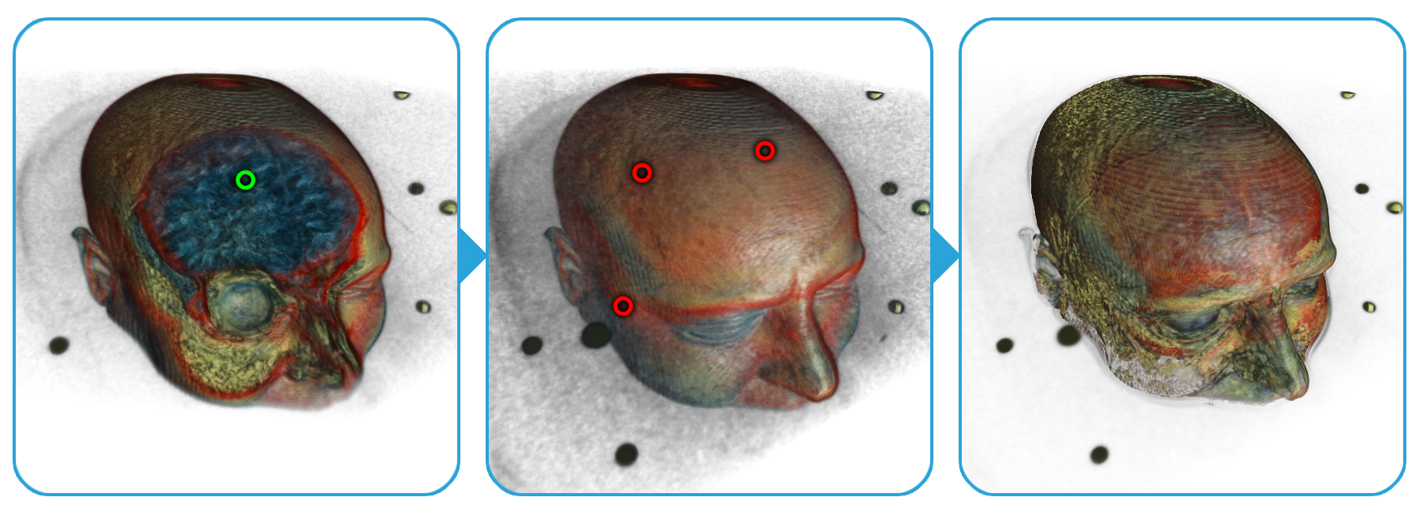
Results
voxMax
gmDiff

Slide 35
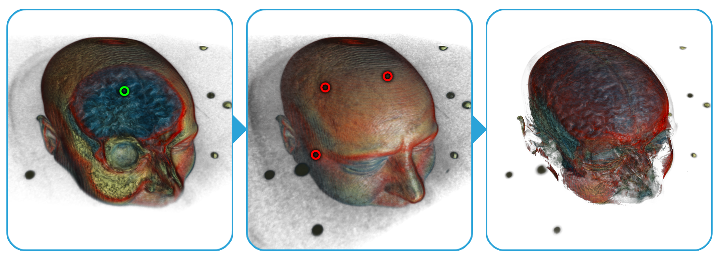
Results
voxDiff
gmMRI

Slide 36
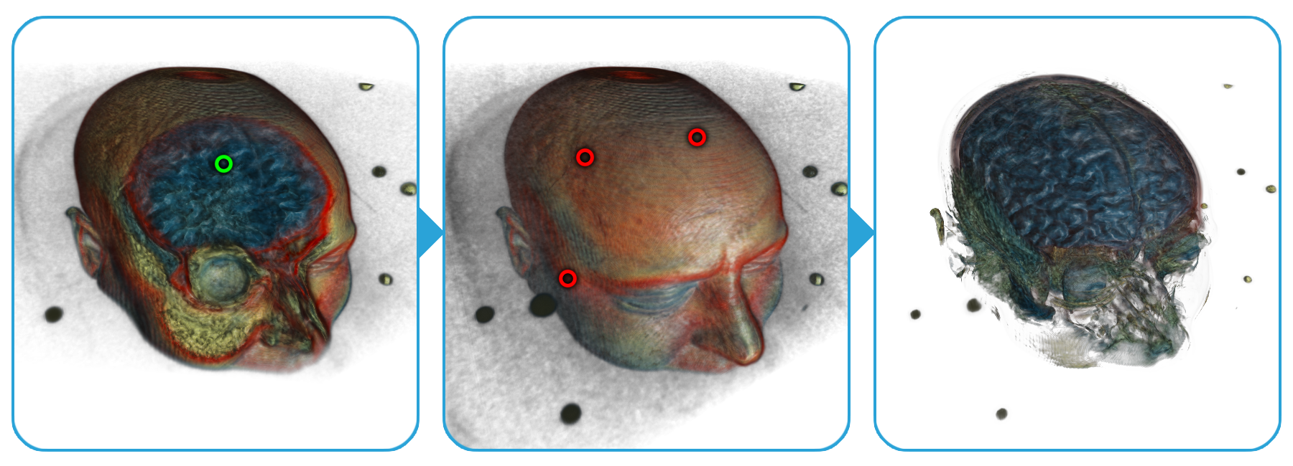
Results
voxDiff
gmMax

Slide 37
2. Multiple Parameter Settings
P. Mindek, M. E. Gröller, and S. Bruckner. Managing Spatial Selections with Contextual Snapshots. Computer Graphics Forum 33, 8 (2014), pp. 132—144. DOI: 10.1111/cgf.12406.
P. Mindek, S. Bruckner, M. E. Gröller. Contextual Snapshots: Enriched Visualization with Interactive Spatial Annotations. In Spring Conference on Computer Graphics, SCCG’13, pp. 49—56, New York, NY, USA, 2013. ACM. The Best Paper Award.
Notes:
15 min
Multiple sets of parameters influencing localized parts of the visualization.

Slide 38
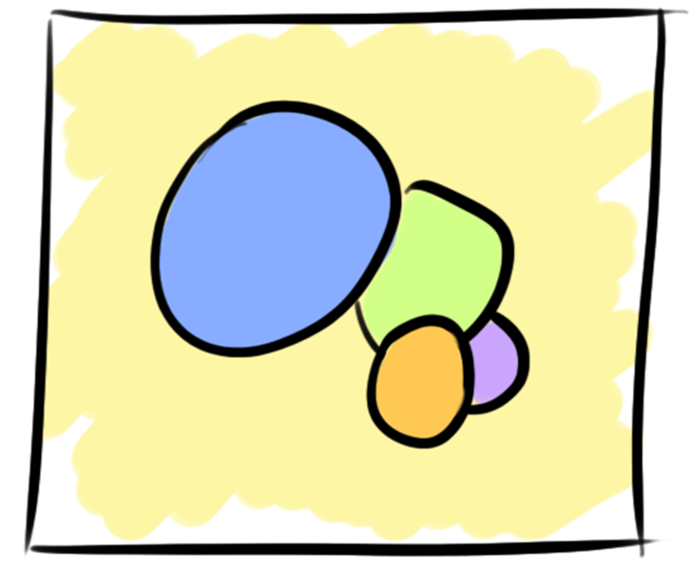
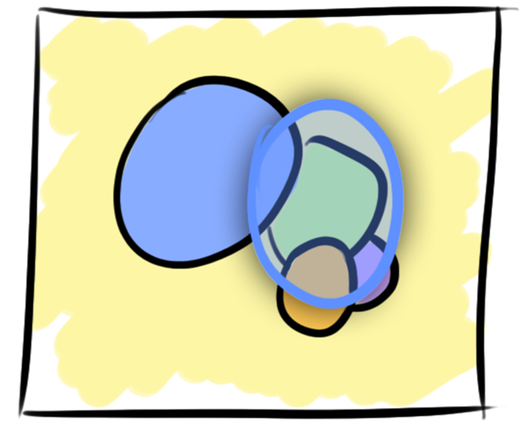
Creating Selections
Image-Space Selection
Object-Space Selection
Image-Space Selection
Object-Space Selection

Slide 39
Context- Dependency
Context:

Slide 40
Contextual Snapshots - Overview
Notes:
Contextual snapshot is an entity which stores spatial selections together with the context in which they were created. Contextual snapshots enable to work with multiple selections created in different stages of the visualization session.

Slide 41
Contributions
Notes:
CSL Library; Embedded Visualizations

Slide 42
Notes:
TODO: prerobit a prisposobit na rozpravanie

Slide 43
Notes:
TODO: prerobit a prisposobit na rozpravanie

Slide 44
3. Multiple Users
P. Mindek, L. Čmolík, I. Viola, M. E. Gröller, S. Bruckner. Automatized Summarization of Multiplayer Games. In Spring Conference on Computer Graphics, SCCG’15, pp. 93—100, Bratislava, Slovakia, Comenius University in Bratislava. The Best Paper Award.
Notes:
25 min
Integration of multiple sets of parameters of multiple users into a single visualization.

Slide 45
Gameplay Storytelling
Reviewing strategies
Advanced replays
Gameplay streaming
Notes:
Body of existing work for gameplay visualization – statistics and such.

Slide 46
Game
Jake2
Bytonic Software

Slide 47
Notes:
Explain what is FPS

Slide 48
Multiplayer Game Summarization
ManyCams

Slide 49
Game Data

Slide 50
Event Graph

Slide 51
Multiplayer Game Summarization
Cinematographic Effects

Slide 53
Seamless View Switching
Notes:
TO-DO: preskocit

Slide 59
4. Interaction
P. Mindek, G. Mistelbauer, M. E. Gröller, and S. Bruckner. Data-Sensitive Navigation in Scientific Visualization. Technical Report TR-186-2-15-01. Institute of Computer Graphics and Algorithms, Vienna University of Technology. April 2015.
Notes:
40 min
Data-sensitive navigation

Slide 60
Traditional Interaction
Input is not proportional to the output.

Slide 61
Data-Sensitive Navigation
Input and output are made proportional.

Slide 62
Data-Sensitive Navigation
Changes in the parameter space are visualized.

Slide 66
Summary

Slide 67
Thank you for your attention!
mindek@cg.tuwien.ac.at

Slide 68
Thank you for your attention!
mindek@cg.tuwien.ac.at

Slide 69
Timings
Introduction – 10 min
Shader Space Exploration – 5 min
Contextual Snapshots – 10 min
Game Summarization (ManyCams) – 15 min
Data-Sensitive Navigation – 5 min

Slide 70
Feature Vectors

Slide 71
Embedded Visualizations

Slide 74
Gameplay Overview

Slide 75
Gameplay Overview

